Slide 1


Policy Advisory Committee
.IE namespace
PAC #10
27 April 2017

Slide 2

Policies in the .IE namespace
Proposals to PAC
Policy change submission
27 April 2017

Slide 3


Agenda
Introduction & background
Proposal
Benefits and Drivers
Policy development process
Q&A

Slide 4
Introduction & Background
In order to register a new .ie domain (nReg) currently you must satisfy two policy requirements:
Connection to Ireland - ”real and substantive connection” of Registrant
Claim to the Name - ”proven claim to the name applied for”

Slide 5
Introduction & Background
The principles of the Managed Registry concept:
  Claim was designed to prevent the anti-social practices of American cybersquatters and domainers
  No need for multiple and/or defensive registrations
  Help to ensure that “good names” were used
  Effort to stop the practice of people registering names
  which will not be used, in the near future.

Slide 6
Introduction & Background
      Our USP - dot ie domains are:
      Identifiably Irish - the only online space reserved for Irish people & businesses
      Trusted through traceability - we’ve checked-out who is behind the website
      Registrants - documented and verified by IEDR
      We can provide assistance to regulatory bodies (IMB /
      ODCE), Law Enforcement etc.

Slide 7
Introduction & Background
What has changed?
Renewed emphasis on developing and growing the national resource / allowing Irish business to have the names they want
People want to have the names they need - but they cannot provide sufficient evidence of a claim to IEDR e.g. Mick / Mick’s blog / Mick’s corner shop
Registries are no longer be responsible for brand protection, via the restriction of applications. Brand managers are making those decisions, esp with 1,200 nTLDs

Slide 8
Our proposal
  Drop the requirement to have, and prove, a claim to the name
  Applicants with a proven real and substantive connection to Ireland will be able to register any name they want.
  Current safeguards to protect citizens and the reputation of the dot ie namespace will continue
  General registration rules will continue
  Dispute resolution policy will continue (WIPO adjudication)

Slide 9
The benefits
  More deterministic registration process (removing subjective ‘claim’ judgements)
  Easier and faster registration process
  Improved customer experience (CX) for Registrars, resellers and registrants
  Dilute the perception of dot ie as ‘hard to get’
  Better potential for repeat business from satisfied customers
  Increased sales and registrations (as dropped tickets are reduced)

Slide 10
Drivers - Customers
Customer expectations have shifted (instant service and gratification are default expectations)
Customer demand has shifted (60% of nReg are in the Discretionary Category)
nReg abandoned because no claim has been submitted within 27 days
Perception that dot ie is hard to get
Some lost sales - almost 10% p.m.
Disappointed rejected applicants
Disgruntled registrants

Slide 11
Drivers - the namespace
To develop and expand the dot ie brand while growing the namespace as a national resource and address issues such as:
Remaining perception that .ie is hard to get
Potential lost sales
Disappointed rejected applicants
To promote Internet usage and uptake by citizens, community groups and micro-businesses
You can now get any name you need for your business,
your residents association, local group

Slide 12
Drivers – IEDR and Registrars
To address administration problems & compliance issues:-
Claim evidence is not deterministic (judgement & opinion involved – throughout the channel)
Baseline PPPRG has exposed 7 pages of Guidelines for nReg
Remove differential treatment of existing businesses v’s future businesses/blogs/events etc.
Where no provable claims exist (in the form of evidence) we accept statements (not documents). But, businesses with copious documents, are being forced to jump through hoops.
We can, and should, rely on other Agencies’ authentication and verification (especially anti-money laundering (AML) checks by banks, estate agents, etc.)

Slide 13
Drivers - Policy
We can update the public policy basis for operating the Managed Registry:-
The claim element of the policy, is no longer contributing to the USP of .ie
The proposed policy shift reflects current international best practices (a move away from prevention and to a focus on take-down / mitigation / exception-handling)
Other policy instruments can deal with problematic registrations
(e.g. DRP, with WIPO, Whois Policy and AUP)
Co-operation with law enforcement has matured in recent years (previously a court order was required to deal with issues)

Slide 14
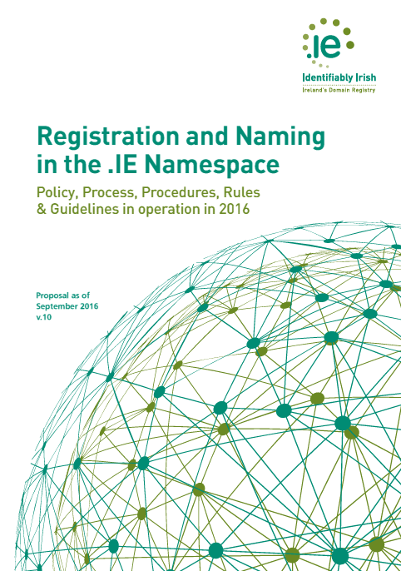
Policy Development Process (PDP)
How will it work?
Policy change request Template
    submitted to PAC on 27 April 2017
10-step PDP
Working group
    edit the PPPRG & identify implementation issues)
Public consultation
Awareness programme
Marketing and promotion of the policy change
Sufficient notice period

Slide 15
Questions & Answers

