Slide 1
Policy Advisory Committee
28th July 2022
Meeting - PAC#32

Slide 2
Policy Advisory Committee
Agenda PAC #32
Membership Matters
Minutes from the PAC #31 meeting
Matters arising
  Domain Alert System to protect products with geographical origin and reputation
Handling of online abuse which uses the .ie namespace
  4.1 GNCCB
  4.2 Netcraft
  4.3 Anti Abuse policy proposal
NIS 2 update
AOB
  CER Directive // Agorateka portal – EUIPO // ADRP stats
Next Meeting

Slide 3
1. Membership Matters
Please keep microphones muted throughout the call
Please “raise a hand” to ask a question or add comments in the chat box
Request to allow the meeting be recorded to assist with minute drafting
  Recording will deleted once the Minutes are approved by PAC

Slide 4
2. Minutes of the PAC #31 Meeting
Meeting minutes are circulated to the membership promptly after each meeting
Comments/feedback accepted over a two week period
If clarifications/edits are requested, and consensus exists, these are reflected in the Minutes
Meeting minutes, and supporting slides, are published on weare.ie after the comment period has ended
Published online at https://www.weare.ie/policy-development-process/

Slide 5
3. Matters arising
Domain Alert System to protect products with geographical origin and reputation:-
  craft and industrial products (e.g Donegal Tweed)
  wine, spirit drinks & agricultural products
CIGIs - regulation on geographical indication protection for craft and industrial products

Slide 6
4.1 Handling of illegality and criminal abuse in the .ie namespace
GNCCB - Suspension Request protocol document
Recap
Agreement reached with the Garda National Cyber Crime Bureau (GNCCB)
Common ground & Goodwill is substantial
  Key engagement at meeting on 10 March 2022 (esp. mutual understanding & due process)
  Agreement confirmed by email 17 May 2022 (circulated with Minutes)

Slide 7
4.1 Handling of illegality and criminal abuse in the .ie namespace
GNCCB - Suspension Request protocol document
Action Items
  Publicity & Communications
  Regular Forum for GNCCB engagement :- invitation to Registrar Day
  Single points of contact (SPOCs)
  Conduit for Engagement with other Garda units

Slide 8
4.2 Handling of technical abuse
Netcraft monitoring service
Recap
Consensus from PAC members
Service commenced March 2021
  Registrar’s role
  Financed by .IE
  Benefits:
    Proactively respond to technical abuse (e.g. malware, phishing or botnets)
    Helps innocent victims (e.g. SMEs who might be unaware that they have experienced a cyber attack)
    Notification allows them to take the required remediation action

Slide 9
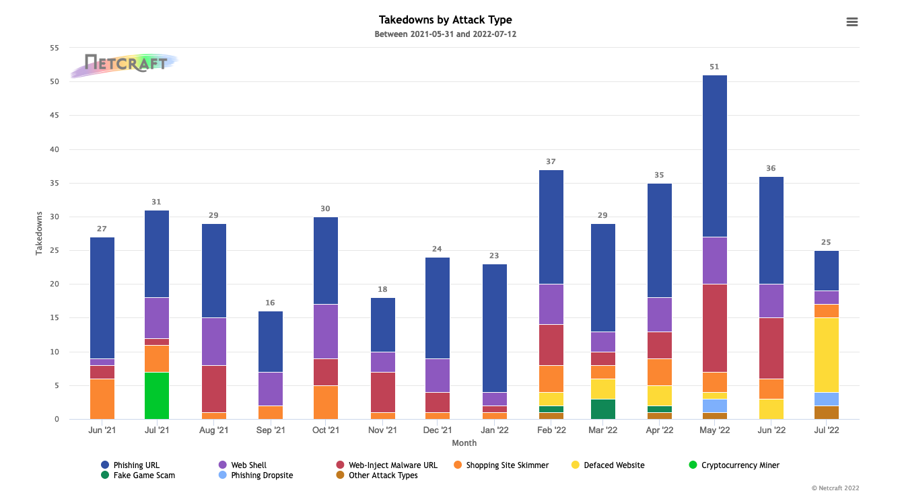
4.2 Handling of technical abuse
Handling of online Technical abuse:-
use of Phishing, Malware, botnets etc
Netcraft service:-
409 attacks
Jun-’21 to Jul-’22

Slide 10
4.3 DNS Abuse – time for a formal .IE Policy ?
(more accurately ‘Abuse that uses the DNS’….)
Recap
Proposal for new, formal .ie policy
Rationale for an Anti-Abuse policy
Context :- digitally transformed post-Covid world (malware, phishing, scams)
EU* regulators attention
Self-regulation provides confidence, builds trust through transparency
ccTLDs may (eventually) follow gTLDs - obliged to have a policy
Discussion deferred
*The European Commission has just published its study on DNS abuse. The study assessed the scope, magnitude and impact of DNS abuse and provided input for possible policy measures. The study proposes a set of recommendations in the field of prevention, detection and mitigation of DNS abuse.

Slide 11
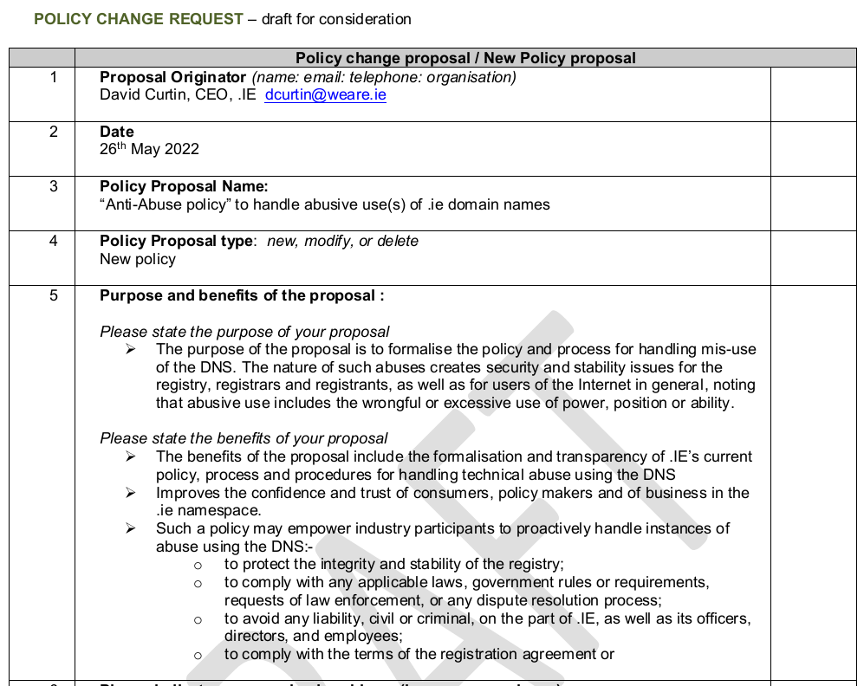
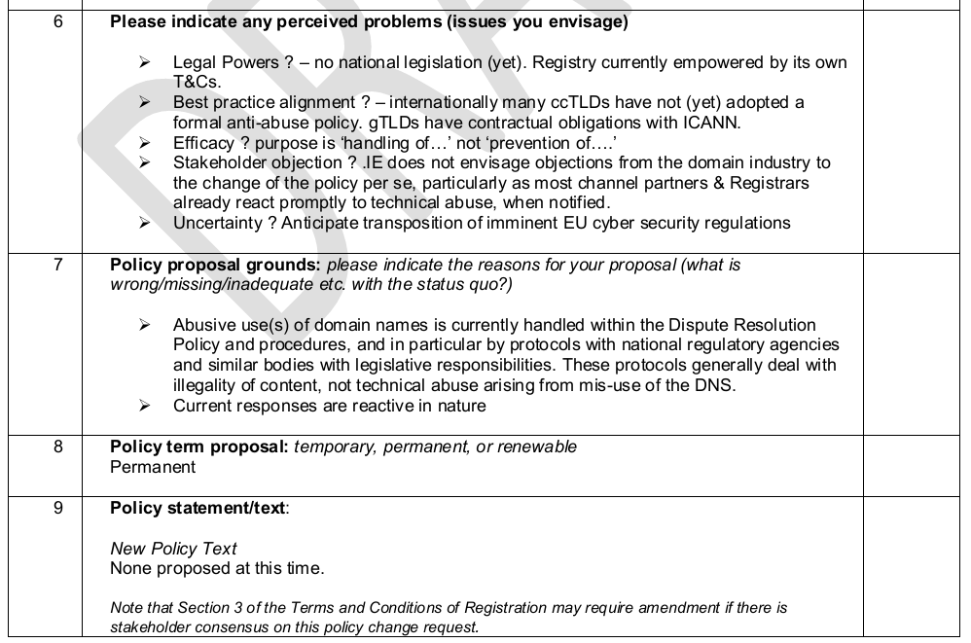
4.3 DNS Abuse – time for a formal .IE Policy ?

Slide 12
5. NIS 2 – update
Update on developments since PAC#31 :-
Timing / Trilogues / and linking DSA & CER Directives.
Czech Presidency continuing where French left off…
12 May – Final stage of Trilogue negotiations
17 June - EU Council published latest version of NIS 2 text
Known as the 4-column doc (472 pages)
Some positive proposed edits from the Council draft…..
Impact Assessment required
  Article 23 – “accurate and complete information, including verification procedures”
  KYC is costly, resource heavy, and introduces friction in automated online processes
  GDPR in Whois proposals - identifying “legal person” in .com TLD world
  Data Access – to legitimate access seekers – lawful and duly justified requests
  Member States have 21 months to transpose
  Scope – registries, registrar and resellers – “entities providing registration services”
  Member States shall “require” Vs shall “ensure”

Slide 13
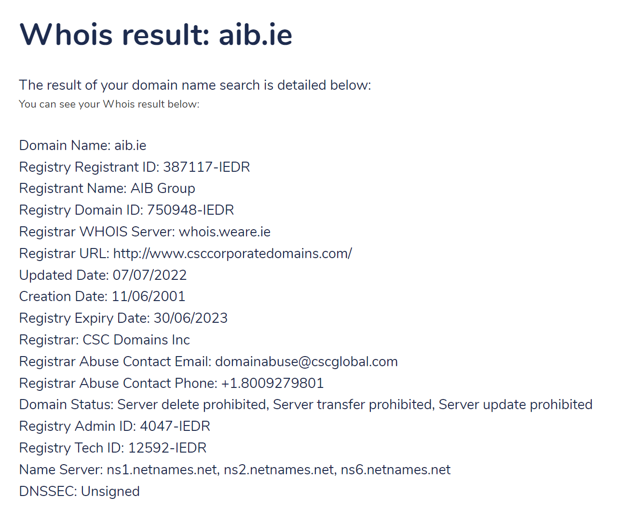
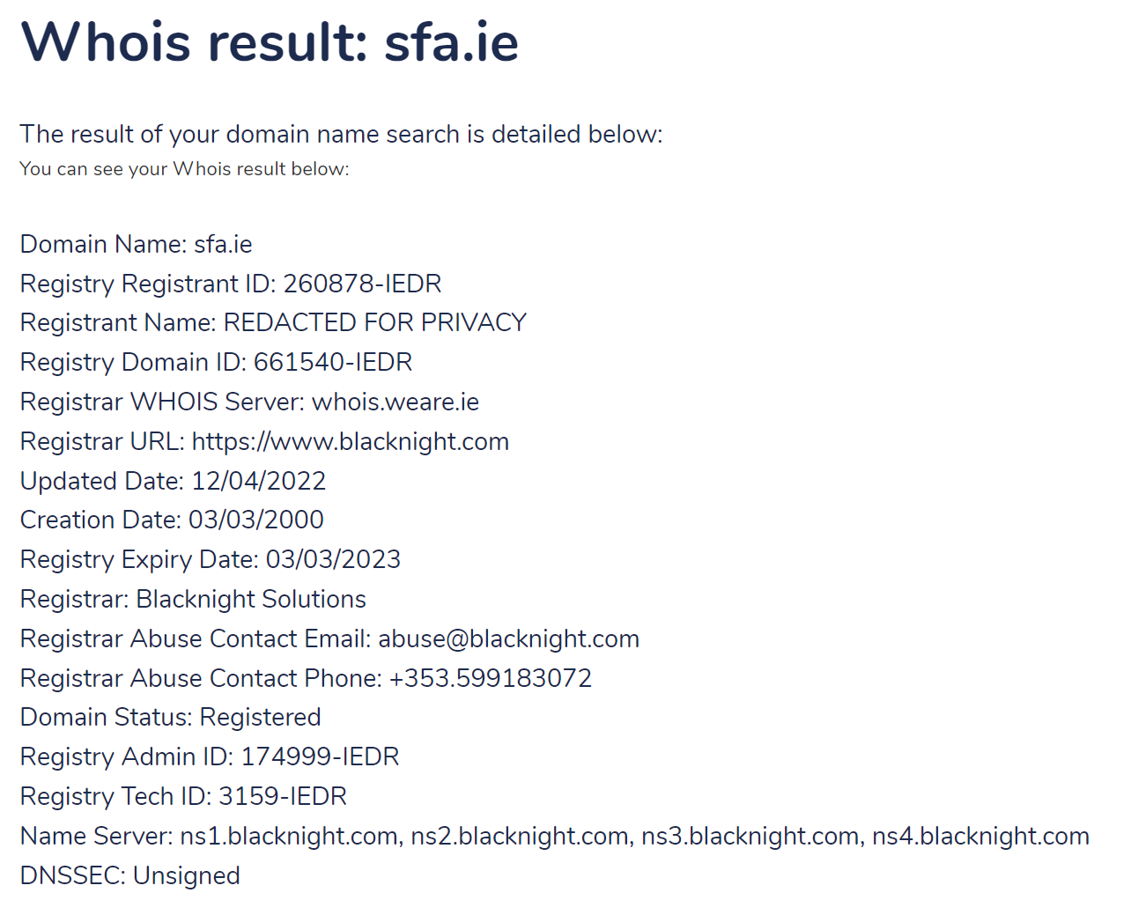
5. NIS 2 – update
Whois – rancorous debates during GDPR

Slide 14
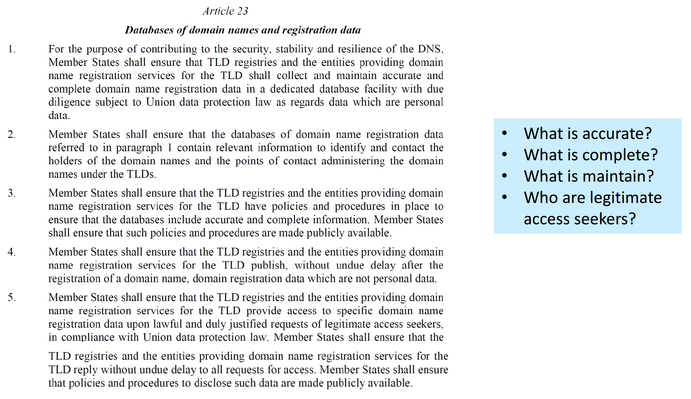
5. NIS 2 – update
Article 23:- implications for data accuracy & completeness

Slide 15
5. NIS 2 – update
Legitimate access seekers
Recital (60)
Legitimate access seekers mean any legal or natural person making a request based on Union or national law.
They include but are not limited to competent authorities under Union or national law for the prevention, investigation or prosecution of criminal offences, and national CERTs, or CSIRTs.
TLD registries and the entities providing domain name registration services should be required to enable lawful access to specific domain name registration data, which are strictly necessary for the purpose of the access request, to legitimate access seekers in accordance with Union and national law.
The request from legitimate access seekers should be accompanied with
a statement of reasons permitting the assessment of the necessity of access to the data.

Slide 16
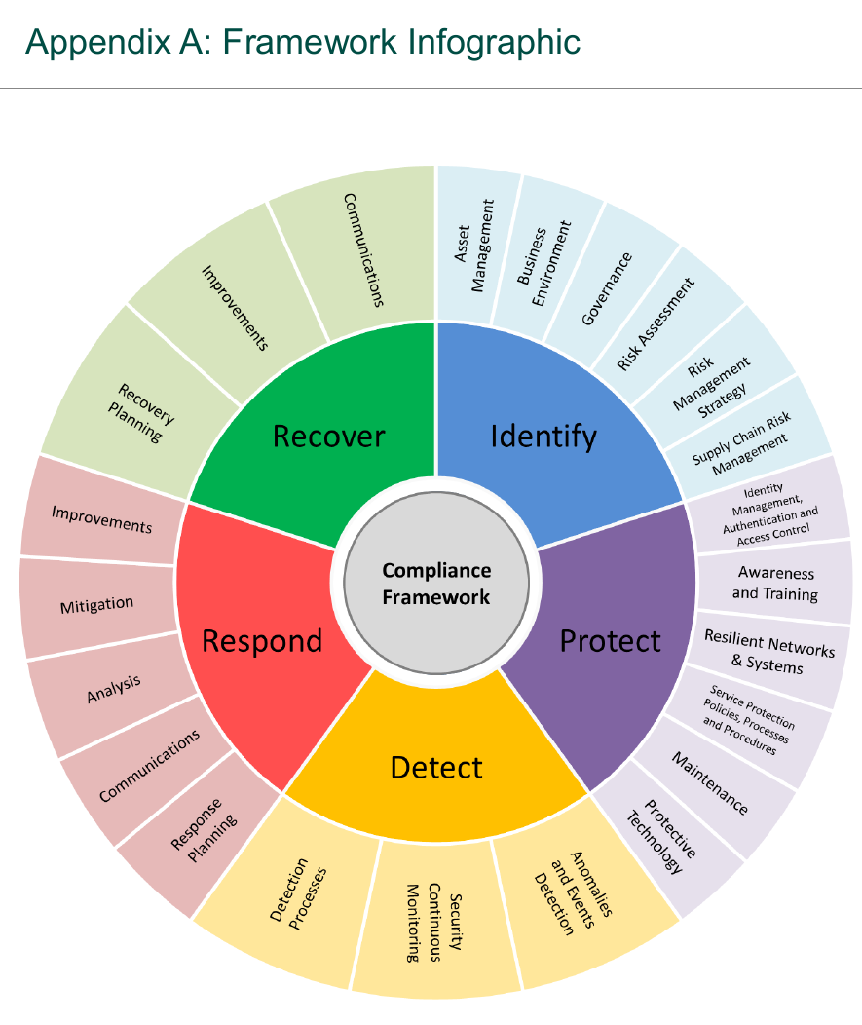
5. NIS2 – update
Evidence of good practices
NIS 2018:-
Regulation 17(1) provides that
Operators of Essential Services shall –
take appropriate and proportionate technical and organisational measures to manage the risks posed to the security of network and information systems which it uses in its operations, and
take appropriate measures to prevent and minimise
the impact of incidents affecting the security of the network and information systems used by it ………………with a view to ensuring the continuity of the provision by it of those services.

Slide 17
5. NIS 2 – update
How can we make progress on ‘The Good’
Legislation is c.21 month away, but cyber threats are here today
Awareness building – “Just inform” via Newsletter, Blogs, Webinars, YouTube clips
    Audience - RAR channel, SMEs in the Supply Chains, TDs & policy makers,
    Messaging :- KYC is costly; Start now on cyber defences, think about ISO alignment 1st;
Share Impact Assessment document – cyber benefits, regulatory cost burden, need for eID,
Lobby letter - to those transposing into national legislation – do’s & dont’s; ask for early clarifications
Engagement - Channel needs a clear legal framework (esp. re conflicts with GDPR provisions)
Cyberthreats – how to improve current resilience and incident response capacities of critical services

Slide 18
6. AOB
CER - Directive for the resilience of critical entities (CER Directive).
Agorateka portal – EUIPO helping users find legally available digital content
(The portal links to national portals that themselves link to websites containing legal offers)
Alternative dispute resolution process (ADRP).

Slide 19
6. AOB
Alternative Dispute Resolution process (ADRP)
Summary ADRP completed cases
13 cases completed since December 2020
11 were transferred to the complainant for the reasons below:
  5 reached a settlement
  4 determined to have been registered in 'bad faith'
  1 determined to have been registered abusively
  1 determined to be potentially harmful to public health
  2 cases were denied:
    1 - the complainant was unable to provide sufficient evidence against the registrant
    2 - no action was initially taken under the ADRP process (although transferred since)

Slide 20
7. Next Meeting
Proposed date:
Thursday 20th October 2022

Slide 21
Policy Advisory Committee
28th July 2022
Meeting - PAC#32

