Slide 1
Policy Advisory Committee
23rd March 2023
Meeting - PAC#34

Slide 2
Policy Advisory Committee
Agenda PAC #34
Membership Matters
Minutes from the PAC #33 meeting
Matters arising
  Domain Alert System to protect CI products with geographical origin and reputation
Handling of online abuse which uses the .ie namespace
  4.1 illegality online (GNCCB protocol)
  4.2 tech abuse (Netcraft stats)
NIS 2 update
AOB
Next Meeting

Slide 3
1. Membership Matters
Please keep microphones muted throughout the call
Please “raise a hand” to ask a question or add comments in the chat box
Request to allow the meeting be recorded to assist with minute drafting
  Recording will deleted once the Minutes are approved by PAC

Slide 4
2. Minutes of the PAC #33 Meeting
Meeting minutes are circulated to the membership promptly after each meeting
Comments/feedback accepted over a two week period
If clarifications/edits are requested, and consensus exists, these are reflected in the Minutes
Meeting minutes, and supporting slides, are published on weare.ie after the comment period has ended
Published online at https://www.weare.ie/policy-development-process/

Slide 5
3. Matters arising
Domain Alert System (DIAS) to protect products with geographical origin and reputation:-
  craft and industrial products (e.g Donegal Tweed)
  wine, spirit drinks & agricultural products
CIGIs - regulation on geographical indication protection for craft and industrial products

Slide 6
4.1 Handling of illegality and criminal abuse in the .ie namespace
GNCCB - Suspension Request protocol document

Slide 7






4.1 Handling of illegality and criminal abuse in the .ie namespace
GNCCB - Suspension Request protocol document
    We have established consumer protection protocols following due process with regulators and others to address online illegality / criminality which involve registry and registrars’ coordination and cooperation.
~ Corporate Enforcement Authority

Slide 8
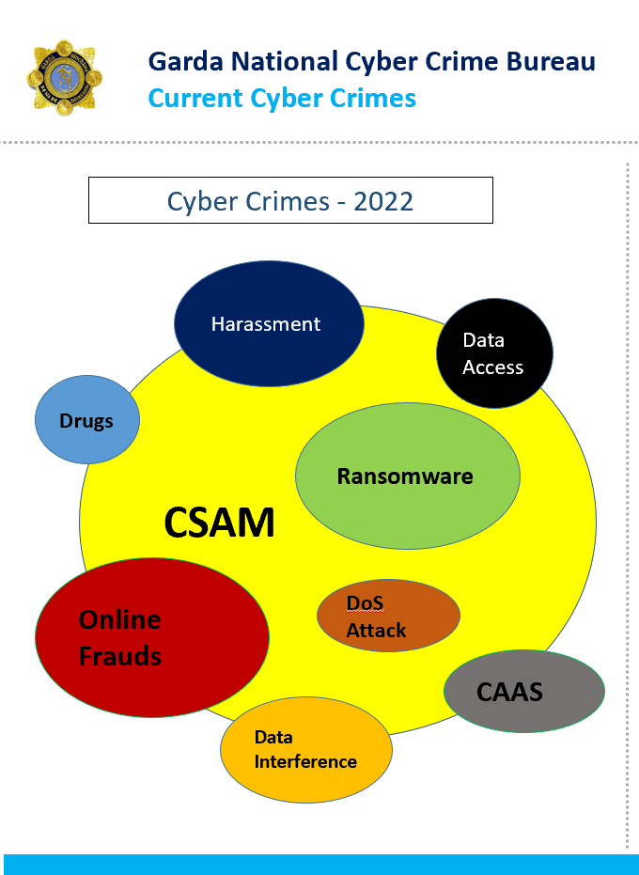

4.1 Handling of illegality and criminal abuse in the .ie namespace
GNCCB - Suspension Request protocol document
Action Items - update
  Publicity & Communications ongoing
  GNCCB presented at Registrar Day in December

Slide 9
4.2 Handling of technical abuse
Netcraft monitoring service
Recap

Slide 10
4.2 Handling of technical abuse
Netcraft monitoring service
Recap
Consensus from PAC members
Service commenced March 2021
  Registrar’s role
  Financed by .IE
  Benefits:
    Proactively respond to technical abuse (e.g. malware, phishing or botnets)
    Helps innocent victims (e.g. SMEs who might be unaware that they have experienced a cyber attack)
    Notification allows them to take the required remediation action

Slide 11
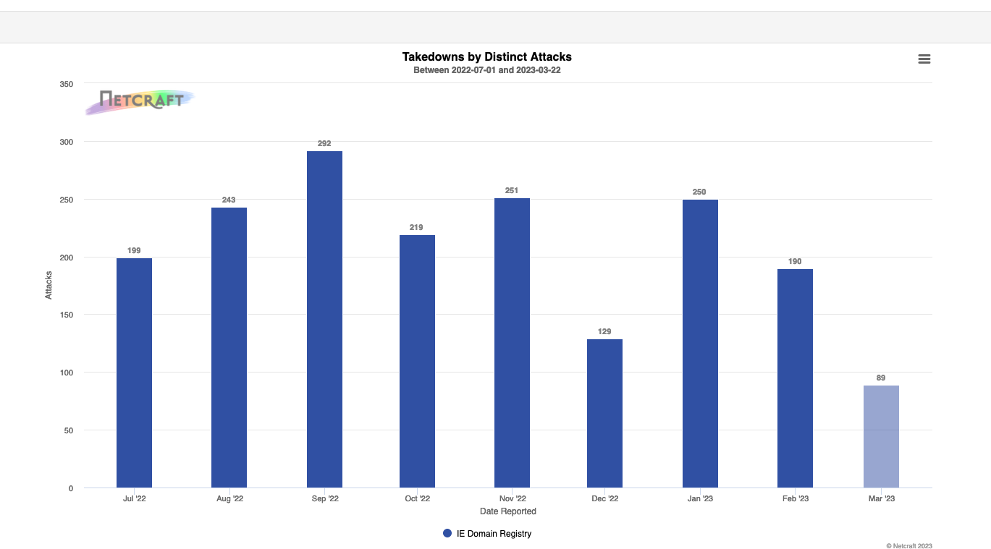
4.2 Handling of technical abuse
Handling of online Technical abuse:-
use of Phishing, Malware, botnets etc…
Netcraft service:-
1,862 attacks
Jul-’22 to YTD’23

Slide 12
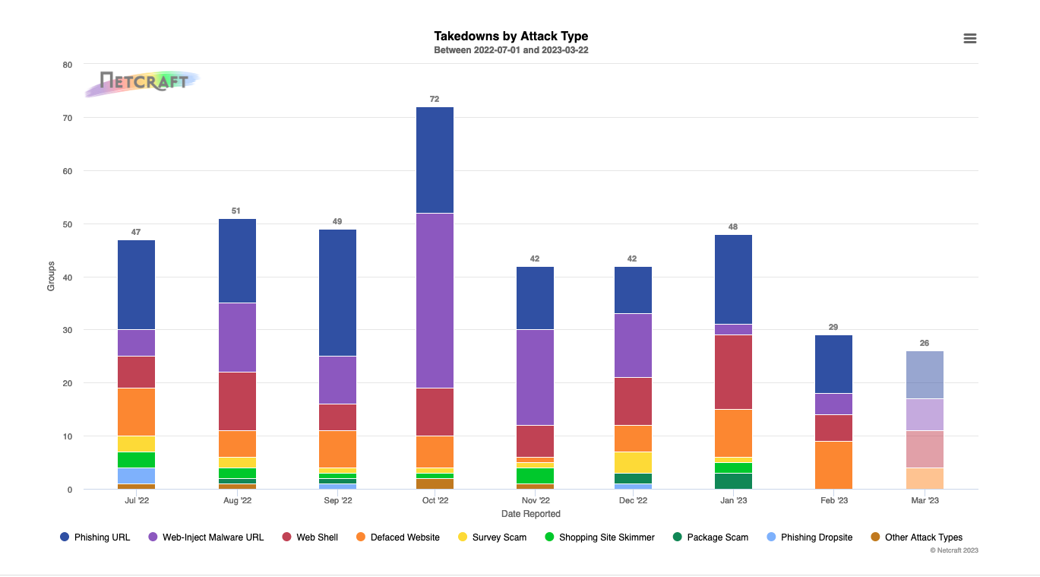
4.2 Handling of technical abuse
Handling of online Technical abuse:-
use of Phishing, Malware, botnets etc
Netcraft service:-
406 takedowns
Jul-’22 to YTD ‘23

Slide 13
5. NIS 2 – Directive on security of network & info systems
Update on developments since PAC#33:-

Slide 14
5. NIS 2 – Directive on security of network & info systems
Update on developments since PAC#33 :-
Timing / Trilogues / and linking DSA & CER Directives.
May 2022 – Final stage of Trilogue negotiations
June 2022 - EU Council published latest version of NIS 2 text
Jan 2023 - Publication in the EU Official Journal (countdown commences).
Impact Assessment (Red – Amber – Green…indicative)
  Article 28 – “accurate and complete information, including verification procedures”
  KYC is costly, resource heavy, and introduces friction in automated online processes
  GDPR in Whois proposals - identifying “legal person” in .com TLD world
  Data Access – to legitimate access seekers – lawful and duly justified requests
  Member States have 21 months to transpose
  Scope – registries, registrar and resellers – “entities providing registration services”
  Member States shall “require” Vs shall “ensure”

Slide 15
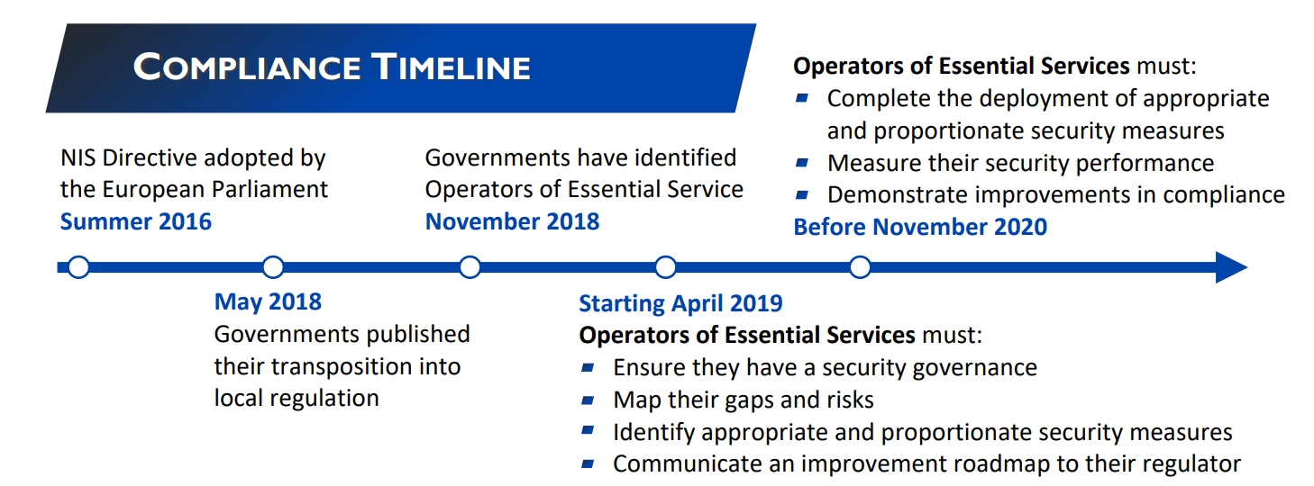
5. NIS 2 – Directive on security of network & info systems
Update on developments since PAC#33 :-
Jan 2023 - Publication in the EU Official Journal (countdown commences).
Now the HARD work really starts …..
Key tasks on the Critical Path e.g. NIS 1 in UK :-

Slide 16
5. NIS 2 – Directive on security of network & info systems
Role for the PAC - How can we make progress on ‘The Good’
Some action items…..
Action “trigger” is the publication in the EU Official Journal
Legislation is c.21 month away, but cyber threats are here today
Awareness building – “Just inform” via Newsletter, Blogs, Webinars, YouTube clips
    Audience - RAR channel, SMEs in the Supply Chains, TDs & policy makers,
    Messaging :- KYC is costly; Start now on cyber defences, think about ISO alignment 1st;
Share Impact Assessment document – cyber benefits, regulatory cost burden, need for eID,
Lobby letter - to those transposing into national legislation – do’s & dont’s; ask for early clarifications
Engagement - Channel needs a clear legal framework (esp. re conflicts with GDPR provisions)
Cyberthreats – how to improve current resilience and incident response capacities of critical service
Notes:
We are just 2 months into a 21-month timeframe…..
We're engaging with others and data gathering at the moment….

Slide 17
5. NIS 2 – Directive on security of network & info systems
Updates from the NIS2 working group
Meeting on 23 February 2023
Not all accredited Registrars are created equal…………..
Size..…ICANN accredited …..ISO certification……..DNS services….Hosting providers
’Importance’ of domains in portfolio…..

Slide 18
5. NIS 2 – Directive on security of network & info systems
Updates from the NIS2 working group
Meeting on 23 February 2023
Importance of engagement with Department of Communications – legislation etc
Risk profile for DECC of .ie Accredited Registrars
KYC - modus operandi, automation, practical difficulties
KYC - smaller registrars will have many difficulties
Need to start the dialogue asap, get ahead of the issues. (Systems changes require lead time)
Treating all registrars equally will be challenging

Slide 19

5. NIS 2 – Directive on security of network & info systems
Updates from the NIS2 working group
Meeting on 23 February 2023
Image – with thanks to CPO magazine
Notes:
Smaller registrars impact…..
Depends on which end of the binoculars you're looking through!
But it's definitely part of the wave of EU regulations coming at us..........FAST !

Slide 20
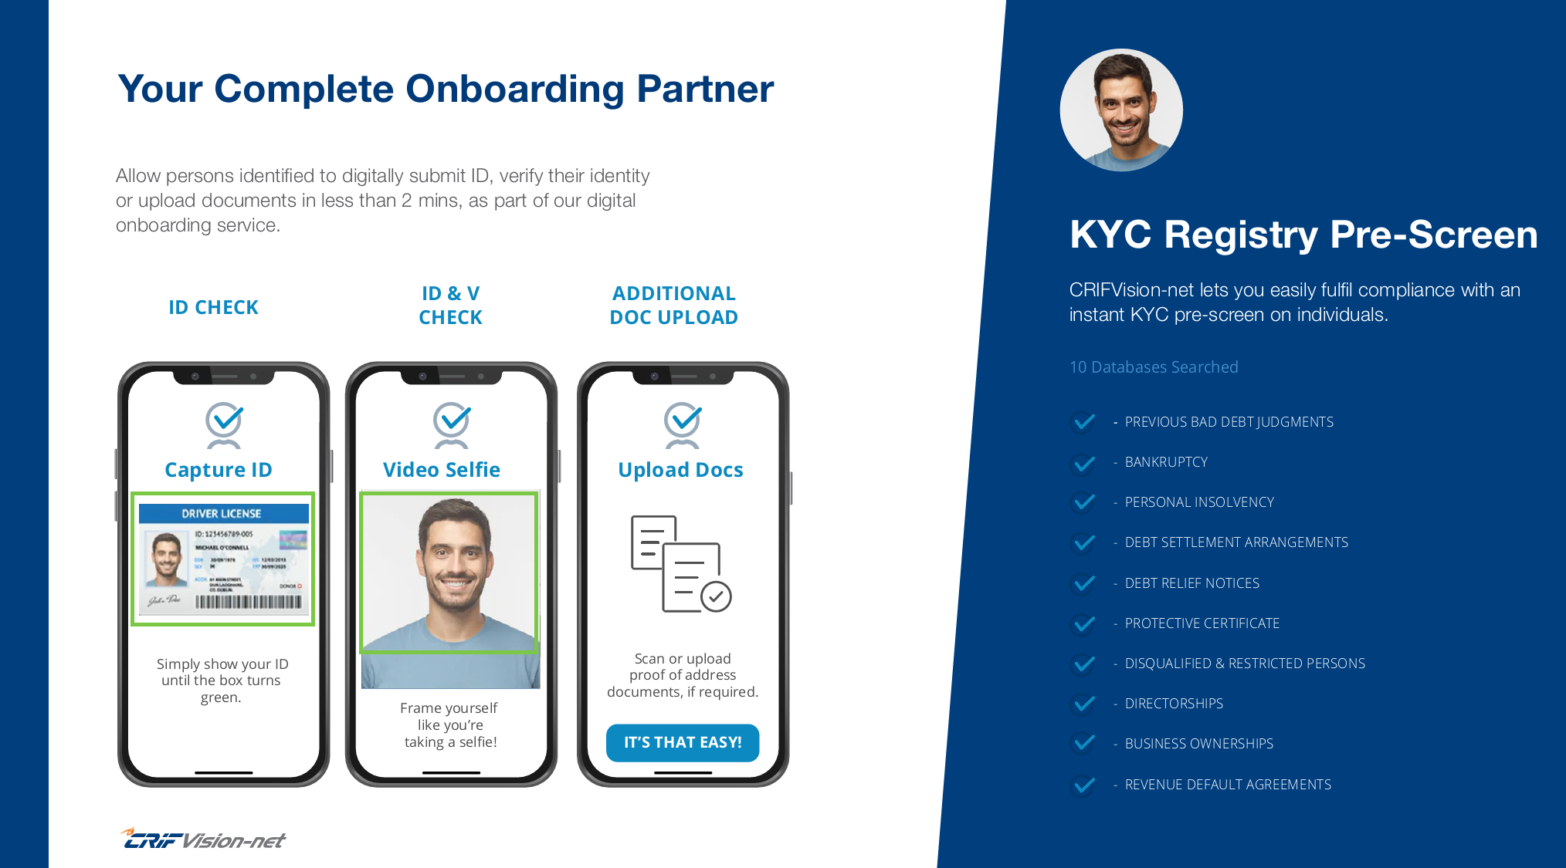
5. NIS 2 – Directive on security of network & info systems
Verification
How ?
By whom ?
Who pays ?
Notes:
Looking across to other sectors
Banks and AML (UGH !!!).... Lets hope that doesn't get that far
We have spoken to vision net about their solution

Slide 21
5. NIS 2 – Directive on security of network & info systems
Updates from CENTR & fellow ccTLDs across EU
European Commission’s call for Tenders
  To procure a study on current and good practices for the collection, maintenance and accessibility of domain name registration data (WHOIS data).
  Results should be "a comprehensive picture of current and future industry practices, and registration technologies".
Commonality of cyber risks – Industry ISAC (information sharing & analysis centres)
Legitimate access seekers - no emerging consensus…. many national flavours
Public access (RDAP as potential successor to WHOIS).
Article 28 (accuracy) - imperative for commonality of responses on KYC - cross-border Registrars
‘ No duplication’ – good intentions – BUT lawyers views on Liability Vs burden on domain holders
Notes:
Information Sharing and Analysis Centers (ISACs) are non-profit organizations that provide a central resource for gathering information on cyber threats (in many cases to critical infrastructure) as well as allow two-way sharing of information between the private and the public sector about root causes, incidents and threats, as well as sharing experience, knowledge and analysis.
.be & .eu …. Sharing information - on fraudsters and on practices of bad actors

Slide 22
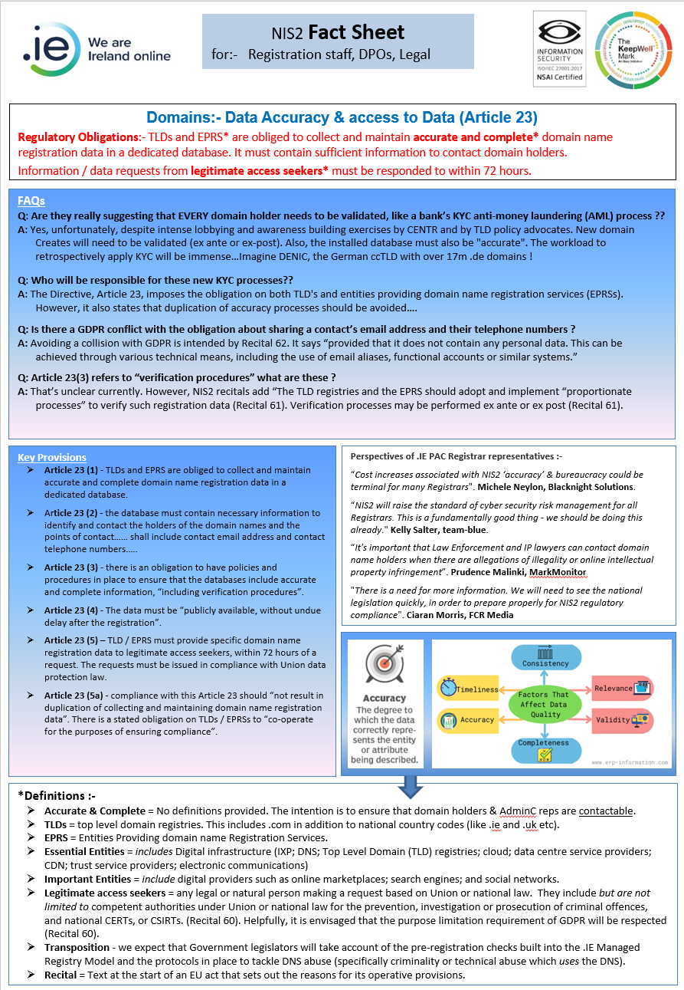
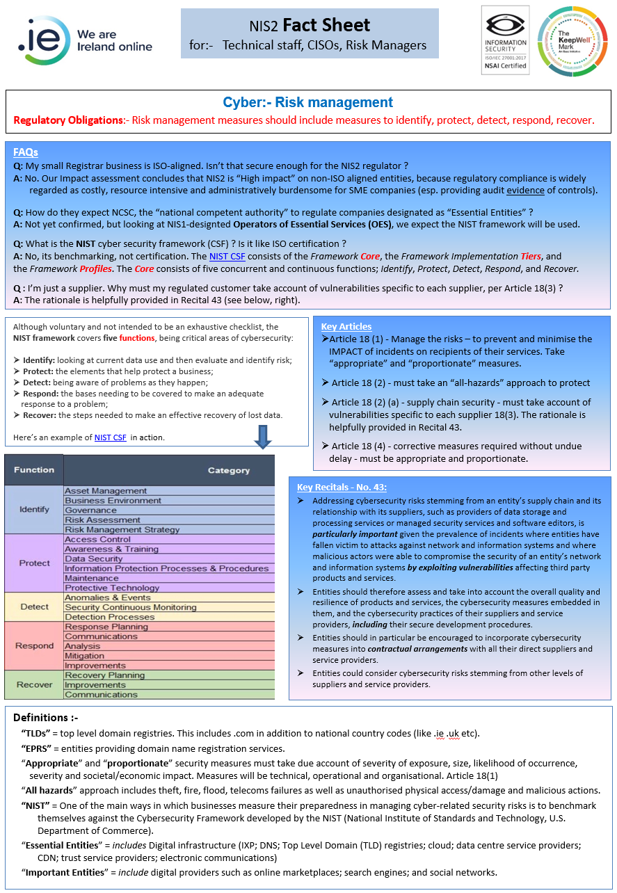
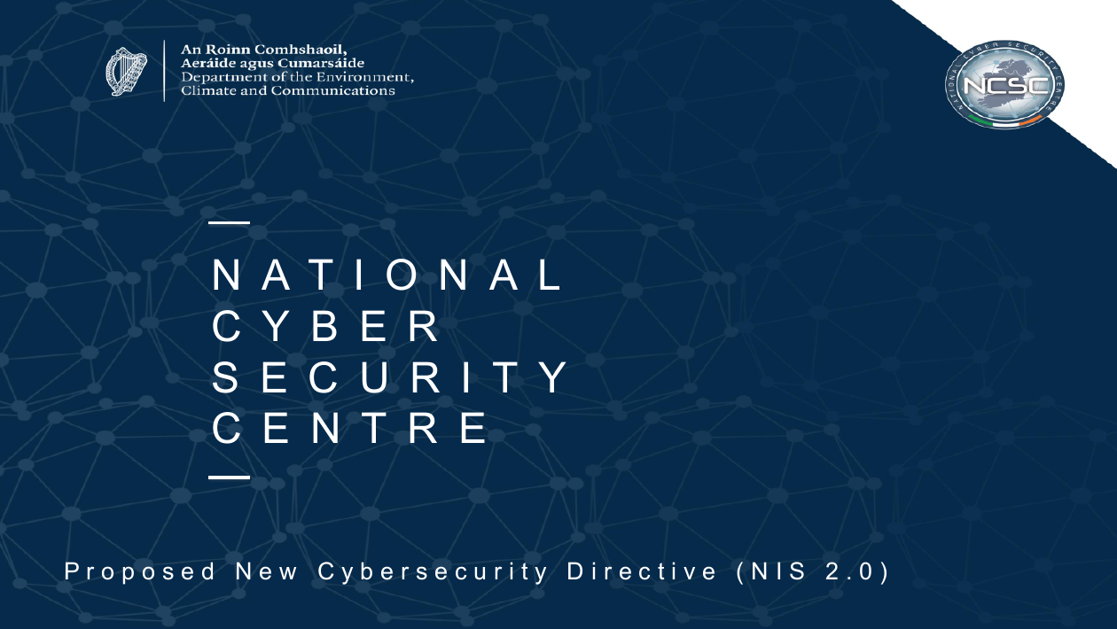
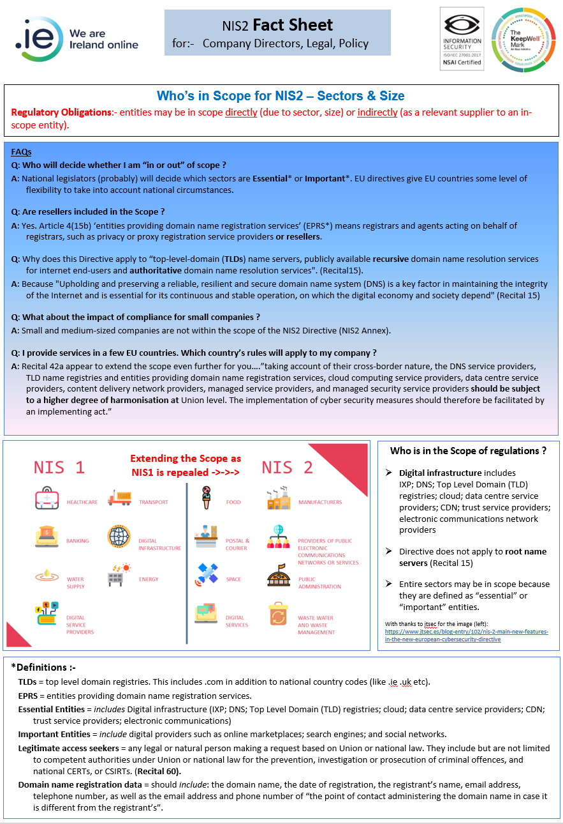
5. NIS 2 – Directive on security of network & info systems
Meanwhile, awareness building has commenced

Slide 23
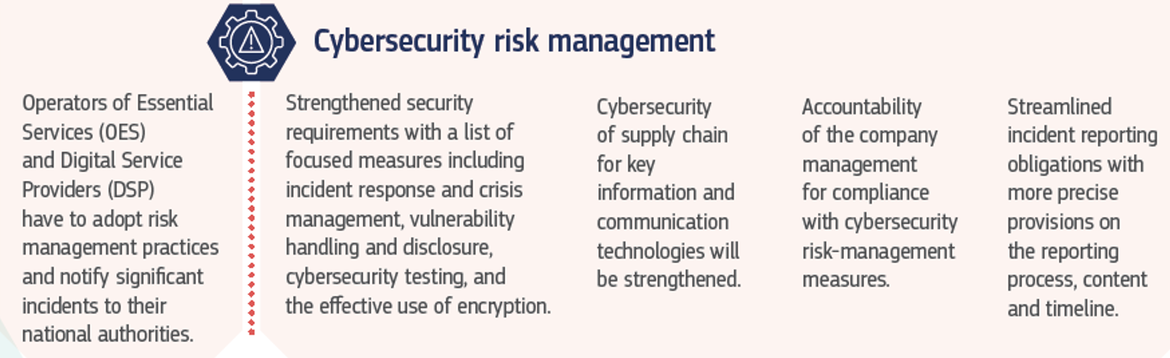
5. NIS 2 – Directive on security of network & info systems
Meanwhile, awareness building has commenced

Slide 24
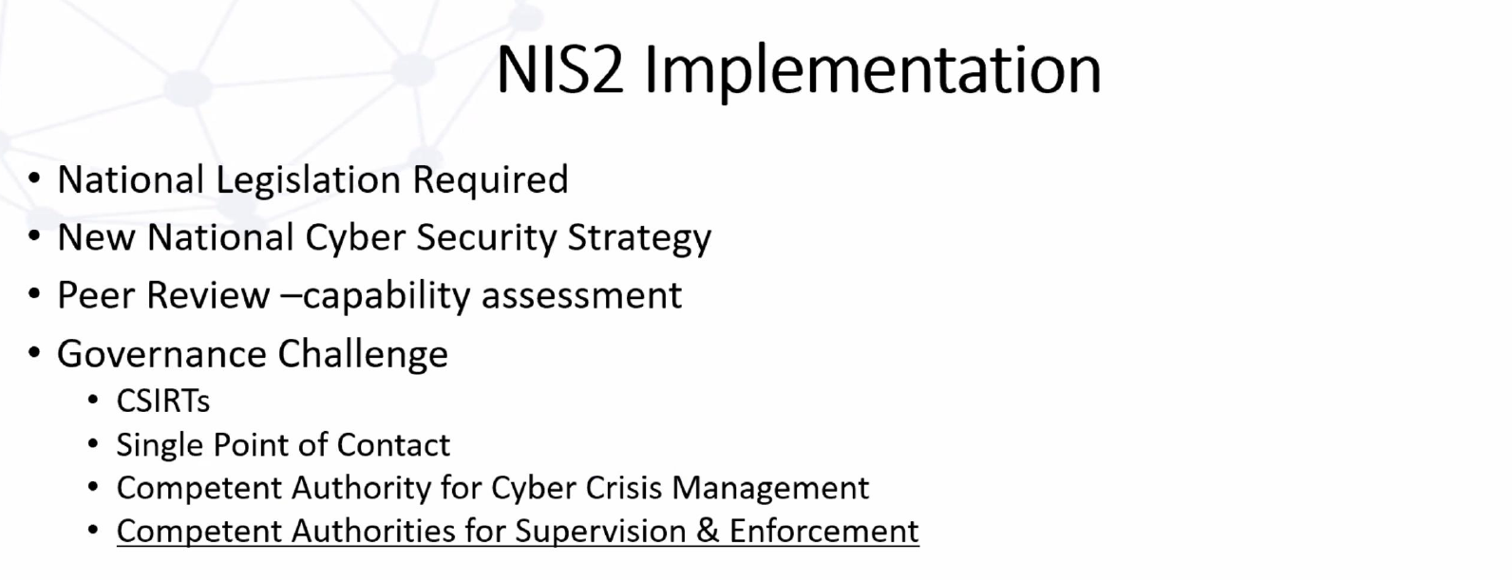
5. NIS 2 – Directive on security of network & info systems
Updates from the NCSC
Source – NCSC presentation – Feb’23

Slide 25
6. AOB

Slide 26
7. Next Meeting
Proposed date:
25th May 2023

