Slide 1
Policy Advisory Committee
25th May 2023
Meeting – PAC 35

Slide 2
Policy Advisory Committee
Agenda PAC #34
Membership Matters
Minutes from the PAC #34 meeting
Matters arising
  Domain Alert System to protect CI products with geographical origin and reputation
Handling of online abuse which uses the .ie namespace
  4.1 illegality online (GNCCB protocol)
  4.2 tech abuse (Netcraft stats)
NIS 2 update
AOB
Next Meeting

Slide 3
1. Membership Matters
Please keep microphones muted throughout the call
Please “raise a hand” to ask a question or add comments in the chat box
Request to allow the meeting be recorded to assist with minute drafting
  Recording will deleted once the Minutes are approved by PAC

Slide 4
2. Minutes of the PAC #34 Meeting
Meeting minutes are circulated to the membership promptly after each meeting
Comments/feedback accepted over a two week period
If clarifications/edits are requested, and consensus exists, these are reflected in the Minutes
Meeting minutes, and supporting slides, are published on weare.ie after the comment period has ended
Published online at https://www.weare.ie/policy-development-process/

Slide 5
3. Matters arising
Domain Alert System (DIAS) to protect products with geographical origin and reputation:-
  craft and industrial products (e.g Donegal Tweed)
  wine, spirit drinks & agricultural products
CIGIs - regulation on geographical indication protection for craft and industrial products
Notes:
[CIGI] From CENTR: On 2 May, the Euro Parl and Council of the EU reached a provisional deal on CIGI regs that removes mentions of the domain info and alert system. But Commission will evaluate if a DIAS is needed after 18 months. Both institutions need to endorse this. CENTR noted the text wasn’t public yet.
[AGRI] From CENTR: On 22 May, European Parliament approved its final position for entering trilogue negotiations with the Council and Commission. Supports the DIAS.
From Mick: We received a list of the domains from Centr and scanned our system,
6450 domains we were sent and we can see there are 93 domains registered with us with life cycle state.

Slide 6






4.1 Handling of illegality and criminal abuse in the .ie namespace
Recap
    We have established consumer protection protocols following due process with regulators and others to address online illegality / criminality which involve registry and registrars’ coordination and cooperation.
~ Corporate Enforcement Authority

Slide 7
4.1 Handling of illegality and criminal abuse in the .ie namespace
Types of Requests
Takedown
This must be done at the Registrar Level. Regulators seeking the permanent deletion of a website should contact Registrars first for quickest resolution (Usually reserved for CSAM, trafficking, criminality or cyber security).
Suspension
The most common request. Regulators may seek a domain name to be immediately suspended to prevent consumer access to the website. Access is still possible with a known IP address. Domain names may be suspended while a resolution is being reached, or a takedown arranged.
Resolution
Unless otherwise requested, the standard process is to engage with the RANT and seek a resolution before any corrective actions are taken (generally relating to web content or fake webshops).
Complaint received from regulator
RANT notified of complaint, given time to comply. RAR also notified.
RANT addresses issue and complies with regulator
Corrective Action taken against RANT
RANT fails to respond or does not comply with regulator
Standard Process*
No further action taken against RANT
*Due to the possible severity of their requests (CSAM, trafficking, etc.), the GNCCB process involves contacting the Registrar first for takedown
Notes:
Things to consider when reviewing the RAP Process:
How best to formalize the intake form while tailoring it for each regulator (e.g., the needs and requests of the Gardai and health authority would be very different).
Should there be a separate form for Data Requests? Or captured under the central RAP form?

Slide 8
4.2 Handling of technical abuse
Netcraft monitoring service
Recap
Consensus from PAC members
Service commenced March 2021
  Registrar’s role
  Financed by .IE
  Benefits:
    Proactively respond to technical abuse (e.g. malware, phishing or botnets)
    Helps innocent victims (e.g. SMEs who might be unaware that they have experienced a cyber attack)
    Notification allows them to take the required remediation action

Slide 9
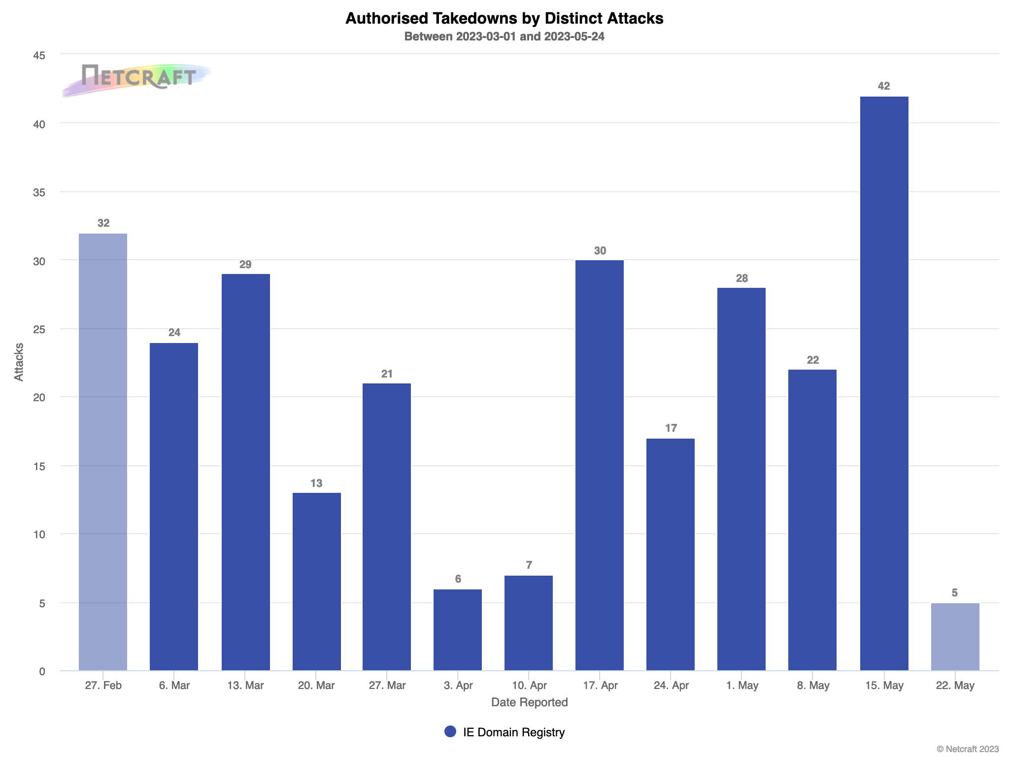
4.2 Handling of technical abuse
Handling of online Technical abuse:-
use of Phishing, Malware, botnets etc…
Netcraft service:-
276 attacks
01 Mar ’23 to 24 May ’23

Slide 10
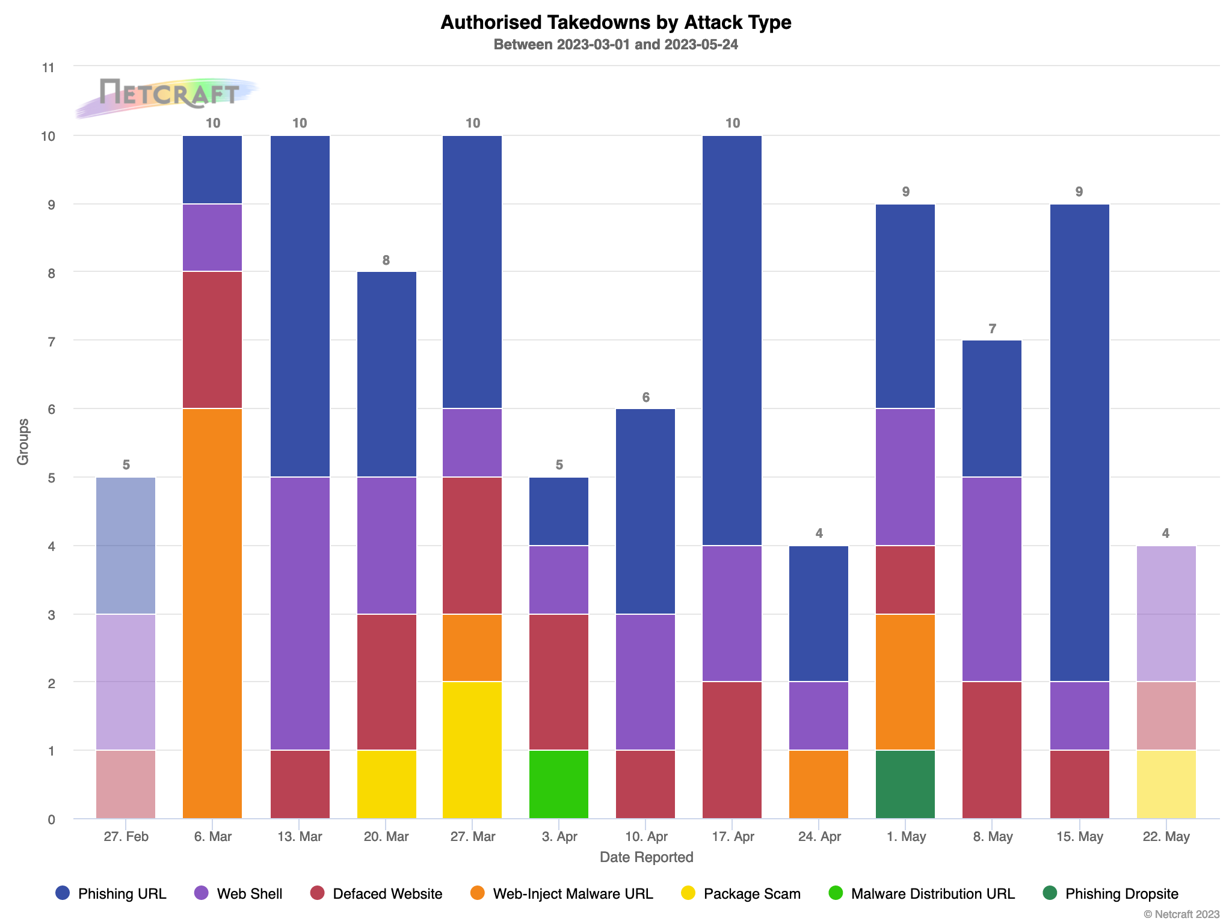
4.2 Handling of technical abuse
Handling of online Technical abuse:-
use of Phishing, Malware, botnets etc
Netcraft service:-
97 takedowns
01 Mar ‘23 to 24 May ‘23

Slide 11
5. NIS 2 – Directive on security of network & info systems
5.1 Updates from the NIS2 working group (Meeting on 18 May 2023)
Met on 18 May 2023 to get approval in principal for an NIS2 Working Plan
A Project Initiation Document which outlined the proposed approach and NIS2 work plan was accepted by the WG
With the approach approved, several Action Items now underway:
  Anonymous Registrar Survey that assesses capabilities & awareness of NIS2 (distributed this week)
  A report of potential impacts on .IE’s policies and procedures from NIS2 (Work-In-Progress)
Next WG meeting TBD, but will strive to meet monthly (frequency will likely increase) as needed
Notes:
Details on the working plan discussed in this deck later on (5.4 and 5.5)

Slide 12
5. NIS 2 – Directive on security of network & info systems
5.2 Road to legislation/regulations in Ireland:
Recap:
10 November 2022 – NIS2 adopted by Council of the EU and European Parliament
16 January 2023 – NIS2 comes into force, beginning countdown to transposition
17 October 17 2024 – Deadline to transpose NIS2 into Irish National Law
At PAC 34 ( 23 March 2023):
  Representative from Department of Environment, Climate & Communications indicated that early engagement on NIS2 was planned for Q2 2023.
  It was expected that work on the legislative process (drafting Heads of the Bill) would commence in Q3 2023.
Notes:
Allow DECC representative to provide any updates if any?

Slide 13
5. NIS 2 – Directive on security of network & info systems
5.3 Key Emerging Issues -Updates from CENTR & fellow ccTLDs across EU
CENTR Jamboree upcoming – More updates expected.
Recent CENTR Legal & Regulatory Tour de Table held 16 May 2023
  ccTLDs in preliminary stages of preparing for NIS2
  Experiences wide-ranging (for example, .at expects government to follow directives closely, while .be expects a “maximalist” approach).
Notes:
(.be, .at, .si, .sk, .pt discussed preparing for NIS2)

Slide 14
5. NIS 2 – Directive on security of network & info systems
5.4 NIS2 Working Plan
Concentrate effort into 3 Focus Areas:
  Alignment – Ensure that .IE policies and procedures comply with legislation.
  Advocacy – Frequently collaborate with policymakers and present the concerns of stakeholders.
  Awareness – Inform stakeholders of upcoming changes, and preparing them for policy changes.
Key Deliverables Include:
  Impact Report – Report on potential impacts of NIS2 on the .ie namespace.
  What-We-Heard Report – Report summarizing stakeholder input, and partners’ input.
  Policy Options – An evergreen document of proposed policy changes. Updated as legislation progresses.
  White Papers/Open Letters/Blogs, etc… – Products used for consultations, advocacy, and awareness building.
Key trade offs that must be balanced:
  Effectiveness – Does the policy address the issue (is it compliant with NIS2?)
  Efficiency – Is the policy scalable and not unduly burdensome?
  Equitability – Does the policy unduly disadvantage, or advantage, any particular group?
  Enforceability – Is the policy reasonable to expect, and impose, compliance upon?

Slide 15
5. NIS 2 – Directive on security of network & info systems
5.5 NIS2 Mandate Tracker
Alignment Ensure that .IE Policies and Processes are aligned with NIS2 requirements | Advocacy Frequently present the concerns and views of stakeholders to policymakers | Awareness Actively inform Registrars of impending changes from NIS2
Comprehensive plan of action was presented and approved by the NIS2 Working Group (May 18, 2023) | Registrar Survey developed and distributed (May 22, 2023) | Registrar Survey developed and distributed (May 22, 2023)
1
Action taken
1
Action taken
1
Action taken
Actions taken since last PAC Meeting (23 March 2023)

Slide 16
6. AOB
Notes:
PAC Recap

Slide 17
7. Next Meeting
Proposed date:
September 2023

