Slide 1


39th Policy Advisory Committee
25 April 2024

Slide 2

Agenda
Introduction & Membership Matters
Matters Arising
  Guest Speaker from Internet Watch Foundation
  Legislative & Regulatory Updates
  Policy Proposals
Internet Governance
  Discussion on the Global Digital Compact
Criminal & Technical Abuse
  NetCraft Service Update
NIS2 Updates
AOB

Slide 3
Membership Matters
Please keep microphones muted throughout the call
Please "raise a hand" to ask a question or add comments in the chat box
Before speaking, please state your name for the record
Meeting will be recorded to assist with minute drafting
Recording will be deleted once the Minutes are approved by the PAC

Slide 4
Minutes of PAC #38
Meeting minutes are circulated to the membership after each meeting.
Comments & feedback are accepted over a two-week period.
If edits are requested, and consensus exists, these are reflected in the Minutes.
Minutes and slides are published on weare.ie after the comment period has ended.

Slide 5

Guest Speaker: Internet Watch Foundation
Legislative & Regulatory Updates
Proposal: Eligible PAC Organisations
Proposal: GDPR Code-of-Conduct
Matters Arising

Slide 6
Guest Speaker – Internet Watch Foundation

Slide 7
Legislative & Regulatory Updates
List is not exhaustive and should not be taken as legal advice.
Intellectual Property
AGRI Reg adopted
Public consultation on CIGI Reg
Public consultation on IPRED
“IP Toolbox” Recommendations
Data Protection
FiDA Regulation
Criminal Justice (Access to Information Systems) Bill
Cybersecurity
National Cyber Security Bill 2024
Miscellaneous
National Risk Assessment 2024

Slide 8
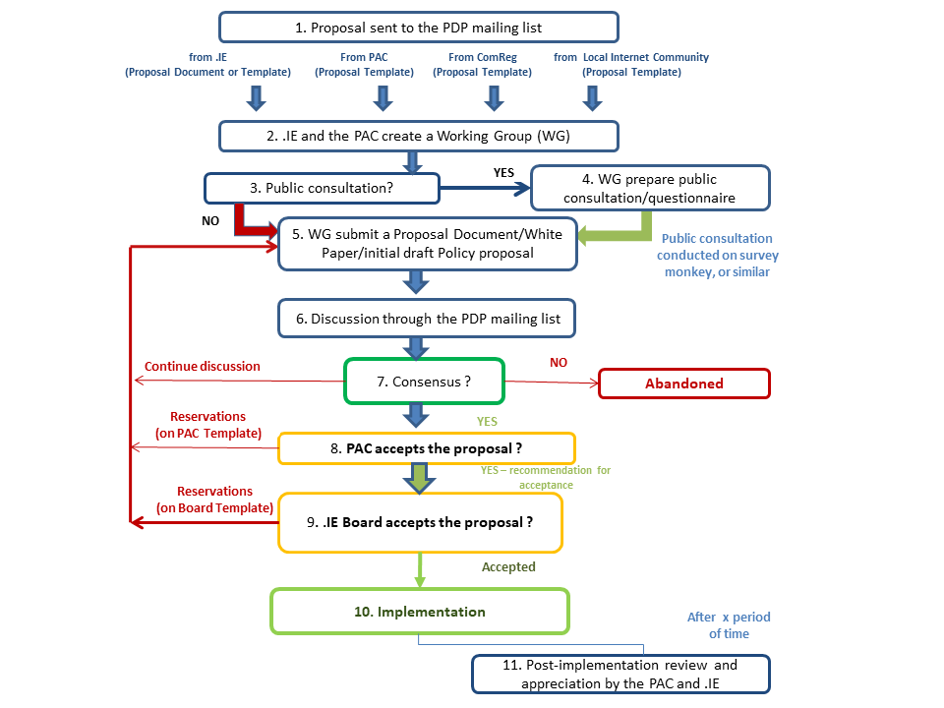
Policy Proposals – Policy Development Process

Slide 9
Proposal: Expanding PAC Eligible Organisations
Proposal: To update the Eligible Organisations list in the PAC Terms of Reference, and expand it to include digital regulators (ComReg, DPC, CCPC, CnaM).
Rationale:
The list is out of date and does not indicate which members are non-voting observers.
The PAC may benefit from cooperation with Digital Regulators Group.
Benefits:
Increased cooperation with regulatory authorities
Risks:
Potential overrepresentation of government officials (mitigated by non-voting status)
Proposed Next Steps:
.ie to prepare a draft list for PAC approval at PAC 40 (11 July 2024)
.ie to seek fast track approval – no dedicated working group or public consultation

Slide 10
Proposal: GDPR Code-of-Conduct
Proposal: To draft a DPC-Approved GDPR Code of Conduct for .ie Accredited Registrars.
Rationale:
Codes of Conduct are voluntary instruments, approved by the DPC, used to promote “legal certainty” in how GDPR should be applied
A Code of Conduct can assist RARs navigate their Article 28 obligations under NIS2
Benefits:
Promotes “confidence and legal certainty” – especially for SMEs
Demonstrates GDPR compliance to regulators (can help mitigate fines & penalties)
Risks:
Potential for lengthy review from and approval from DPC
Requires “sufficient” public consultation
Proposed Next Steps:
Work on a Code of Conduct to be incorporated into the NIS2 Working Group’s mandate
Public Consultation with Registrars to be sought as part of PDP

Slide 11
Proposal: GDPR Code-of-Conduct
EXAMPLE FOR ILLUSTRATIVE PURPOSES
Control | Control Guidance | GDPR
A RAR shall have public policies & procedures to enable lawful access to registration data for legitimate access seekers. | Policies and procedures should be public and ensure that requests are lawful and duly substantiated, accounting for the principles of data processing. They should ensure that: requests are made under Union or Member State law requests are accompanied by a clear statement of purpose the statement of purpose is sufficient to allow for the necessity of the request to be evaluated the requested registration data is accurate and up-to-date access to the registration data is granted no longer than is necessary for the stated purpose access is granted in a way that ensures appropriate security; and, the request is appropriately documented | Article 5

Slide 12

Internet Governance
Discussion on the Global Digital Compact

Slide 13
Global Digital Compact
Initiative from UN Sec-Gen’s Envoy on Technology. Seeks to outline “shared principles for an inclusive, open and secure digital future”
Covers subjects like connectivity, internet fragmentation, human rights online, data protection, etc…
Zero Draft published on 1 April 2024 (intergovernmental negotiations until June). Generally positive reviews from technical community on current draft.
Points of Contention from Tech Community:
  Use of ‘multi-stakeholder cooperation’ instead of ‘governance’
  Creation of new UN office for Digital & Emerging Tech
Ongoing engagement on international level.

Slide 14
Criminal & Technical Abuse
Updates from NetCraft Service

Slide 15
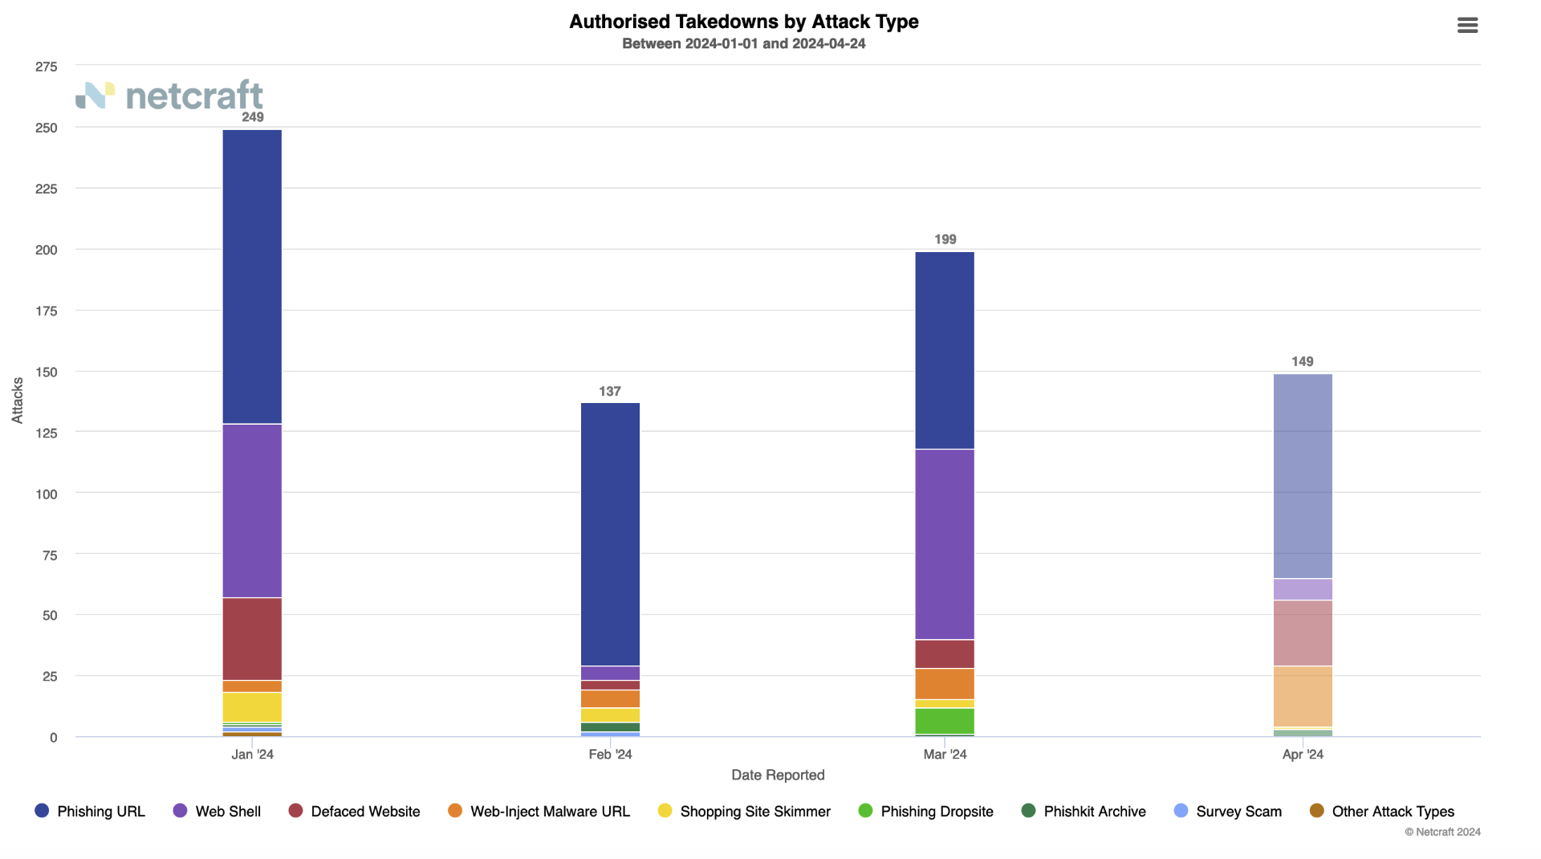
NetCraft
Number of Attacks (YTD)

Slide 16
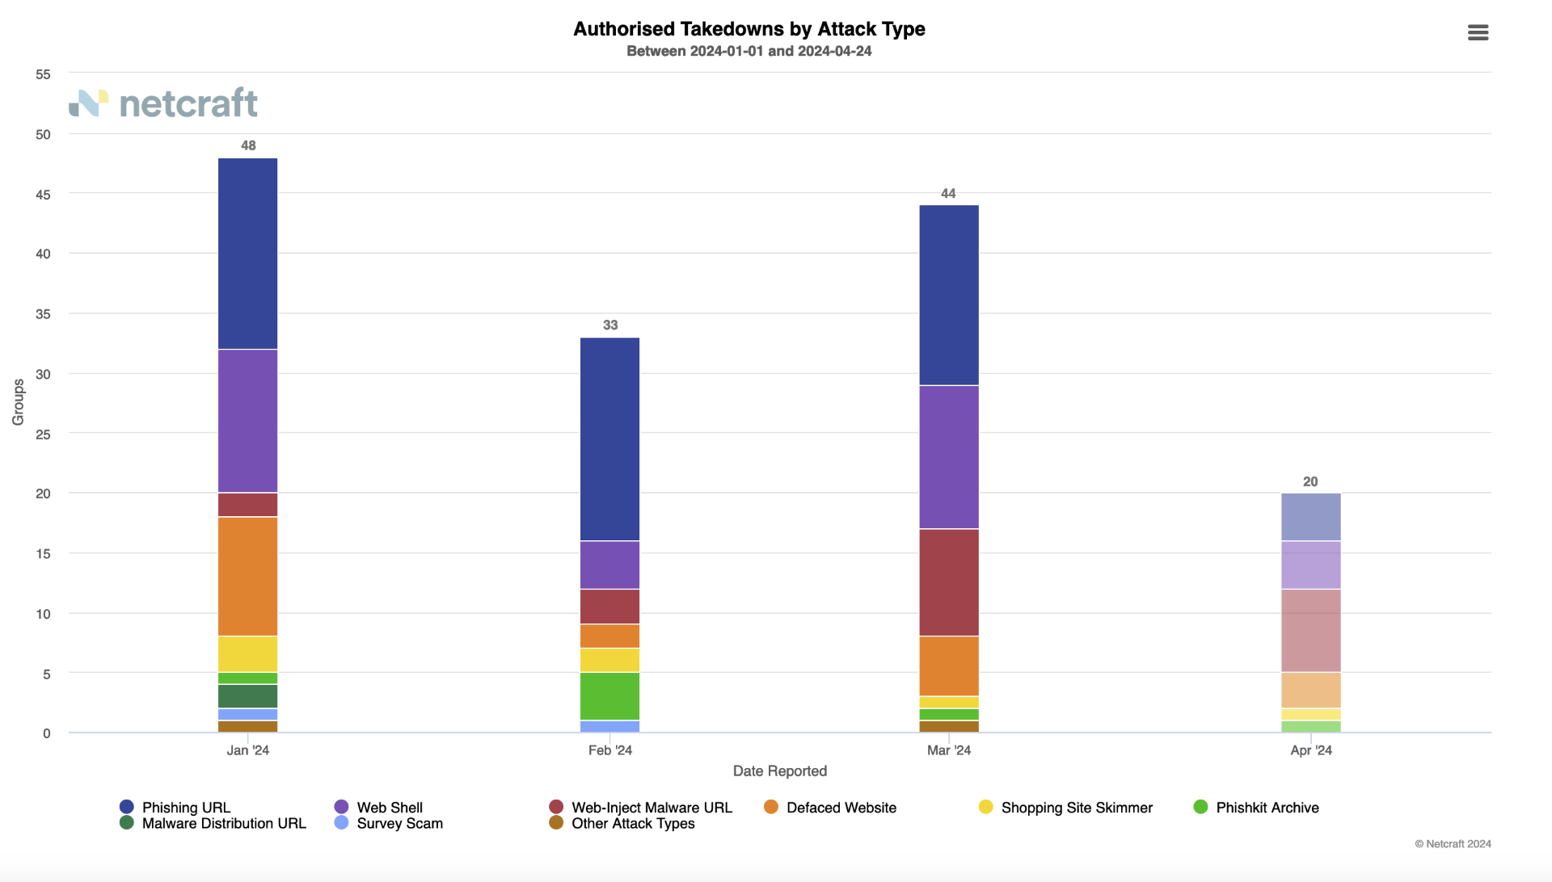
NetCraft
Attacks by Group (YTD)

Slide 17
Roadmap & Tracker
Key Updates
Updates from Working Group
Tour de Table
NIS2

Slide 18
NIS2 Roadmap
Task Complexity
High:
Med:
Low:
 | Q2 2023 | Q3 2023 | Q4 2023 | Q1 2024 | Q2 2024 | Q3 2024 | Q4 2024
Stage | Preliminary Analysis |  | Advocate & Monitor |  |  |  | Implement
Legislative Milestones |  | Awaiting Heads of Bill | Awaiting Heads of Bill | Awaiting Heads of Bill | Awaiting Heads of Bill | Legislative Process | Transposed by Oct 17th
Alignment
Advocacy
Awareness
Audit Policy Impacts
Policy Impact Report
What We Heard Report
Adjust policy options as legislation evolves to ensure alignment
Fast Track Changes
Registrar Capacity Survey
Monitor legislative changes at each stage
PAC / Working Group Engagement (On-Going)
White Papers for public consultations
Advocate to relevant policymakers
RAR webinars for awareness
Registrar webinar trainings on final policy requirements
Open Letters and Blog Posts on NIS 2 Implications
ICANN & CENTR calls, conferences and workshops as needed

Slide 19
Tracker
Actions taken since last PAC Meeting (29th Feb 2024)
Alignment Ensure that .IE Policies and Processes are aligned with NIS2 requirements | Advocacy Frequently present the concerns and views of stakeholders to policymakers | Awareness Actively inform Registrars of impending changes from NIS2
NIS2 WG Meeting held (23 March 2024) ICANN 79 Participation Engagement with NCSC Compliance Unit | Preparing consultation materials for PLS | NIST RAR Webinar in March Preparing follow up survey on RAR Awareness of NIS2
2
Actions taken
1
Actions taken
2
Action taken

Slide 20
Key Updates
Croatia & Belgium passed transposed NIS2 into National Law.
National Cyber Security Bill listed for Priority Drafting in Legislative Programme
Updates from NCSC:
RARs are considered part of the RGY's supply chain. RGY must assess RARs and manage identified risks as the RGY "sees fit." (NIST SP 800-161).
Guidelines are being produced from the "WHOIS workstream on "verification." Guidelines will likely be finalised second week of May.
To avoid duplicating data collection, RGYs and RARs must cooperate. The Directive does not prescribe any "specific implementation model."
Questions awaiting a response on:
Will the existing WHOIS database need to be updated and verified all at once?

Slide 21
Tour de Table

Slide 22
Next PAC Meetings:
  11 July 2024
  10 October 2024
  12 December 2024
AOB & Next Meeting

Slide 23


