Slide 1
Policy Advisory Committee
7th December 2023 Meeting – PAC #37

Slide 2
Policy Advisory Committee
Agenda PAC #37
Membership Matters
Minutes from the PAC #36 meeting
Matters arising
Proposal for Miscellaneous Amendments to the .ie Policy Suite
CIGI and AGRI Regulations
Handling of online abuse which uses the .ie namespace
NIS 2
5.1 Roadmap & Mandate Tracker
5.2 Key Emerging Issues
5.3 Updates
5.4 Discussion
AOB
Next Meeting

Slide 3
1. Membership Matters
Please keep microphones muted throughout the call
Please “raise a hand” to ask a question or add comments in the chat box
Request to allow the meeting be recorded to assist with minute drafting
Recording will be deleted once the Minutes are approved by PAC

Slide 4
2. Minutes of the PAC #36 Meeting
Meeting minutes are circulated to the membership promptly after each meeting
Comments/feedback accepted over a two week period
If clarifications/edits are requested, and consensus exists, these are reflected in the Minutes
Meeting minutes, and supporting slides, are published on weare.ie after the comment period has ended
Published online at https://www.weare.ie/policy-development-process/

Slide 5
3. Matters arising
Misc. Amendments to the .ie Policy Suite
Policy Proposal to make non-substantive amendments to the .ie Policy Suite:
Policies have not been updated since 2020.
Proposal would make minor changes (such as removing out of date references, etc.)
The proposal was distributed to PAC Members on 20 November 2023. Feedback from one member was incorporated.
Future proposals for re-structuring the .ie Policy Suite planned in the lead up to NIS2

Slide 6
3. Matters arising
Misc. Amendments to the .ie Policy Suite
PROPOSED CHANGES:
All Policies
References and links to “iedr.ie” be changed to “weare.ie”
References to .IE Domain Registry CLG be changed to “.IE Domain Registry CLG, trading as .IE”
Privacy Policy
Data Protection Officer name and contact info be published
The policy for seeking proof of identity for data subject rights have less prescriptive wording.
“PII” be changed to “personal data”
Data and Document Retention Policy
The definition of “Data Controller” be reworded for consistency with the DPC
Charity Policy
The section providing instructions on applying through the “IEDR Console” be removed.

Slide 7
3. Matters arising
Misc. Amendments to the .ie Policy Suite
Q1: Does the Policy Advisory Committee agree with the following:
The proposal for miscellaneous amendments to the .ie Policy Suite (the Proposal) does not receive a dedicated internal working group
The Proposal does not undergo a public consultation
The Proposal does not have a dedicated White Paper developed
Consensus on this Proposal will be sought by attendees of the 37th Policy Advisory Committee
If Q1 is agreed upon by the PAC, then:
Q2: Does the Policy Advisory Committee agree with the proposed changes to the .ie Policy Suite?

Slide 8
3. Matters arising
Updates on Geographical Indications(GI) Regulations
Craft & Industrial Products (CIGI):
Entered into force on 16 November 2023.
ccTLDs must ensure that ADR procedures recognise GIs as an invokable right
Commission shall carry out a feasibility study of a domain name info alert system (DIAS) by 2 June 2026.
Wine, Spirits & Agricultural Products (AGRI):
Provisional deal reached 24 October 2023.
ccTLDs must ensure that ADR procedures recognise GIs as an invokable right
Enforcement actions to remove and disable access to domain names.
EUIPO may establish and manage a DIAS on a voluntary basis with ccTLDs.
Commission reserves the right to mandate use of the DIAS after a feasibility study.

Slide 9
4. Handling of illegality and criminal abuse in the .ie namespace
Updates
New legislation to monitor:
Proposed EU Regulation on Financial Data Access (Article 18) - If Competent Authorities (CA) have no other way to prevent or end a breach of the regulation, and there is risk of "serious harm" to consumer interests, the CA may take actions which include:
Removing content or restricting access to online interfaces (OI);
Ordering a hosting service provider to remove, restrict, or disable access to an OI; and,
"Order domain registries or registrars to delete a fully qualified domain name" and allow the CA to record the deletion.
Digital Service Bill 2023 - gives effect to some provisions of the Digital Services Act in Ireland. Section 34 enables Digital Service Commissioner to request an "Access Blocking Order" from the High Court. The High Court may issue an Access Blocking Order if it is satisfied of the following:
There is an ongoing infringement of the Digital Services Regulation;
The infringement involves a criminal offence which poses a threat to the life or safety of persons;
The Digital Services Commission has taken all reasonable steps to end the infringement; and,
The order is proportionate (considers nature, gravity, recurrence, and duration).
Access Blocking Orders subject to requirements (limited to 28 days but can be extended, mandatory notice periods, opportunities for appeals, etc.).

Slide 10
4. Handling of technical abuse
Netcraft monitoring service
Recap
Consensus from PAC members
Service commenced March 2021
Registrar’s role
Financed by .IE
Benefits:
Proactively respond to technical abuse (e.g. malware, phishing or botnets)
Helps innocent victims (e.g. SMEs who might be unaware that they have experienced a cyber attack)
Notification allows them to take the required remediation action

Slide 11
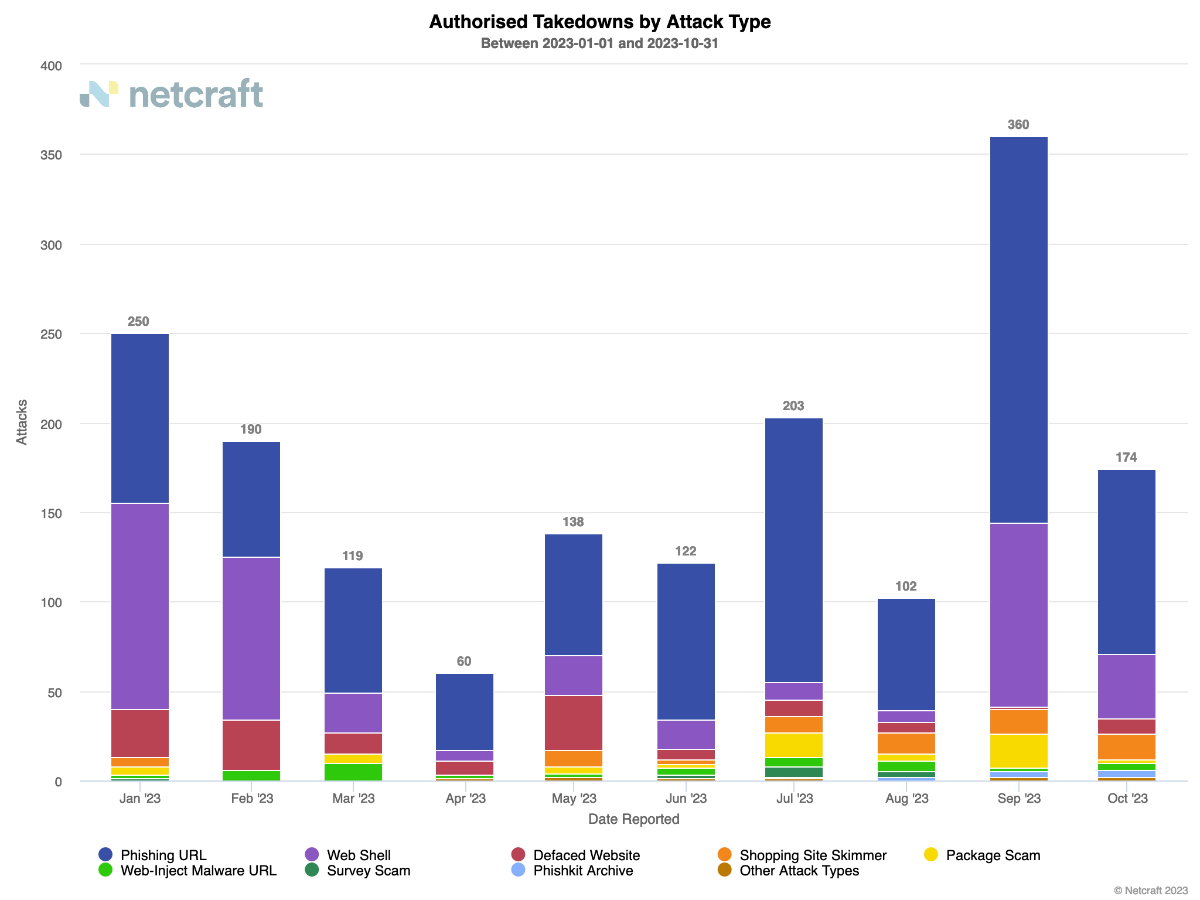
4.2 Handling of technical abuse

Slide 12
5. NIS 2 – Directive on security of network & info systems
Recap – Updated Roadmap
 | Q2 2023 | Q3 2023 | Q4 2023 | Q1 2024 | Q2 2024 | Q3 2024 | Q4 2024
Stage | Preliminary Analysis |  | Advocate & Monitor |  |  |  | Implement
Legislative Milestones |  | Government drafts Heads of Bill | Government publishes Heads of Bill | Pre-Legislative Scrutiny & Report | Legislative Process Continues | Legislative Process Continues | Directive transposed by Oct 17th
Alignment
Advocacy
Awareness
Task Complexity
High:
Med:
Low:
Registrar Capacity Survey
Policy Impact Report
What We Heard Report
Adjust policy options as legislation evolves
Fast Track Changes
Monitor legislative changes at each stage
PAC / Working Group Engagement (On-Going)
White Papers for public consultations and/or Committee submissions (if option available)
Correspondence with relevant policymakers
Newsletter and RAR webinars for awareness
Registrar webinar trainings on final policy requirements
Open Letters and Blog Posts on NIS 2
ICANN & CENTR calls, conferences and workshops as needed

Slide 13
5. NIS 2 – Directive on security of network & info systems
5.1 NIS2 Mandate Tracker
Actions taken since last PAC Meeting (14 Sep 2023)
Alignment Ensure that .IE Policies and Processes are aligned with NIS2 requirements | Advocacy Frequently present the concerns and views of stakeholders to policymakers | Awareness Actively inform Registrars of impending changes from NIS2
NIS2 WG Meeting held (23 Nov 2023) Participation in CENTR & ICANN events regarding NIS2 (ongoing) | Call with DECC & NCSC officials held about how.ie registration validation processes (Oct 2023) What We Heard Report drafted based on engagement to date (Nov 2023) | Webinar for Registrars on NIS2 implications held (12 Oct 2023) Brief presentation at Registrar Day on NIS2 (5 Dec 2023)
2
Actions taken
2
Actions taken
2
Action taken

Slide 14
5. NIS 2 – Directive on security of network & info systems
5.2 Key Emerging Issues
Government Legislation Programme (Sept 2023)
National Cyber Security Bill announced.
Will transpose NIS2 in Ireland.
Heads of Bill and Competent Authority announcement forthcoming
CENTR L&R Workshop (Sept 2023)
CENTR working group on “registration verification” determined that cross-border harmonisation was unlikely. Focused instead on making recommendations to NIS Cooperation Group and Member States about Article 28 Implementation.
ICANN 78 Day 0 Workshop on NIS2 (Oct 2023)
Article 28 will not be covered by an Implementing Act – will be left to the Member States.
NIS Cooperation group will be drafting guidelines that cover Article 28 through two task forces: one on verification, and one on legitimate access seekers.

Slide 15
5. NIS 2 – Directive on security of network & info systems
5.3 Updates from the NIS2 working group
Met on 23rd November 2023
Topics covered included:
Engagement Plan on NIS2;
What We Heard Report; and,
the drafted recommendations from CENTR on Article 28.

Slide 16
5. NIS 2 – Directive on security of network & info systems
5.3 Updates – What We Heard Report
Engagement to date:
Ongoing meetings with Policy Advisory Committee and internal NIS2 Working Group
Bilateral engagement with government officials from Department of Environment, Climate & Communications (DECC)
Awareness building with Registrars through newsletters, survey, and webinars
Ongoing collaboration with other ccTLDs through CENTR and ICANN events
Main Themes:
Concerns about disproportionate burden
Concerns about the lack of clarity on NIS2’s implementation and scope
Concerns about the level of Registrar awareness
Desire for collaboration with government and cross-border partners

Slide 17
5. NIS 2 – Directive on security of network & info systems
5.4 Discussion – CENTR Recommendations
Proportionality
Diverse approaches
Gradual implementation
Risk based
Hybrid approach
Respectful of GDPR
Pre-delegation and post-delegation
Access to eID and Gov databases
Flagging issues with legal entities

Slide 18
6. AOB

Slide 19
7. Next Meeting Proposed date: 29 February 2024 -or- Post ICANN 79

