Slide 1
Policy Advisory Committee
29th February 2024 Meeting – PAC #38

Slide 2
Policy Advisory Committee
Agenda PAC #38
Membership Matters
Minutes from the PAC #37 meeting
Matters arising
Conclusion of Policy Change (Misc. Amendments to Policy Suite)
Legislative and Regulatory Updates
Handling of online abuse which uses .ie namespace
4.1 Criminal Abuse – illegality online
CSAM & TLD Hopping (IWF Domain Alert Program)
Tour de Table – Digital Services Act 2024
4.2 Technical Abuse – NetCraft (Update from CIO)
NIS 2 Updates
5.1 Tracker and Roadmap Update
5.2 Key Updates
5.3 Updates from NIS2 Working Group
5.4 Tour de Table – Updates from Participants
5.5 Upcoming NIST Webinar
6. Discussion – 2024 Priorities for the PAC
AOB
WSIS+20
PAC Membership
8. Next Meeting – 25th April 2024

Slide 3
1. Membership Matters
Please keep microphones muted throughout the call
Please “raise a hand” to ask a question or add comments in the chat box
Request to allow the meeting be recorded to assist with minute drafting
Recording will be deleted once the Minutes are approved by PAC

Slide 4
2. Minutes of the PAC #37 Meeting
Meeting minutes are circulated to the membership promptly after each meeting
Comments/feedback accepted over a two week period
If clarifications/edits are requested, and consensus exists, these are reflected in the Minutes
Meeting minutes, and supporting slides, are published on weare.ie after the comment period has ended
Published online at https://www.weare.ie/policy-development-process/

Slide 5
3. Matters arising
Misc. Amendments to the .ie Policy Suite
Policy Proposal to make non-substantive amendments to the .ie Policy Suite.
The proposal was accepted by PAC at PAC 37.
The proposal was also accepted by the Board in December 2023.
Policies on the website have been updated.

Slide 6
3. Matters arising
Legislative and Regulatory Updates
*Not an exhaustive list*
National
National Cyber Security Bill (Transposes NIS2)
Digital Services Act 2024
Criminal Justice (Protection, Preservation of and Access to Data on Information Systems Bill) 2024
EU
Digital Services Act (Implementing Regulation)
eEvidence Regulation
CIGI/AGRI Regulations
Financial Data Access (FiDA) Proposal

Slide 7
4. Handling of illegality and criminal abuse in the .ie namespace
CSAM & TLD Hopping (IWF Domain Alert Program)
Partnership with Public Interest Registry (PIR) and Internet Watch Foundation (IWF) based in UK.
Program seeks to combat ‘TLD Hopping’ of sites dedicated to commercial CSAM.
PIR offering to sponsor any registry taking part in program.
Participation in the program offers:
Access to TLD Hopping List
Real-time domain alerts to participating registries
Discussion: What are PAC Members’ initial views or concerns?

Slide 8
4. Handling of illegality and criminal abuse in the .ie namespace
Tour de Table – Digital Services Act 2024

Slide 9
4. Handling of technical abuse
Netcraft monitoring service
Recap
Consensus from PAC members
Service commenced March 2021
Registrar’s role
Financed by .IE
Benefits:
Proactively respond to technical abuse (e.g. malware, phishing or botnets)
Helps innocent victims (e.g. SMEs might be unaware that they have experienced a cyber attack)
Notification allows them to take the required remediation action

Slide 10
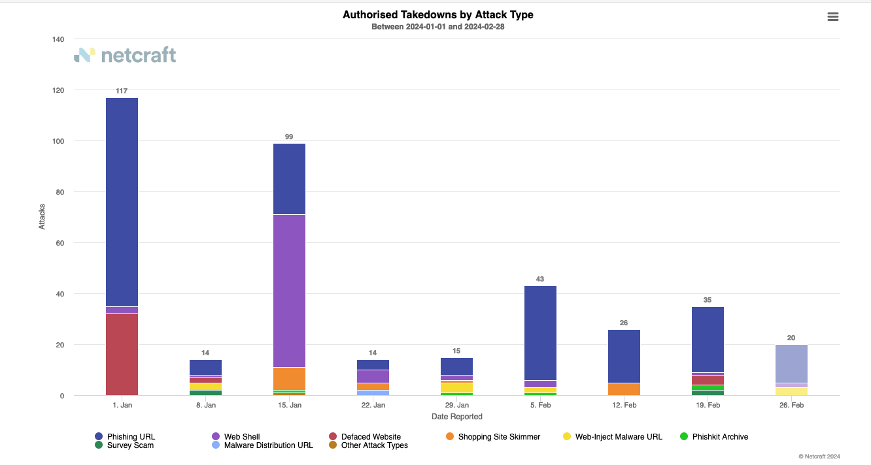
4.2 Handling of technical abuse

Slide 11
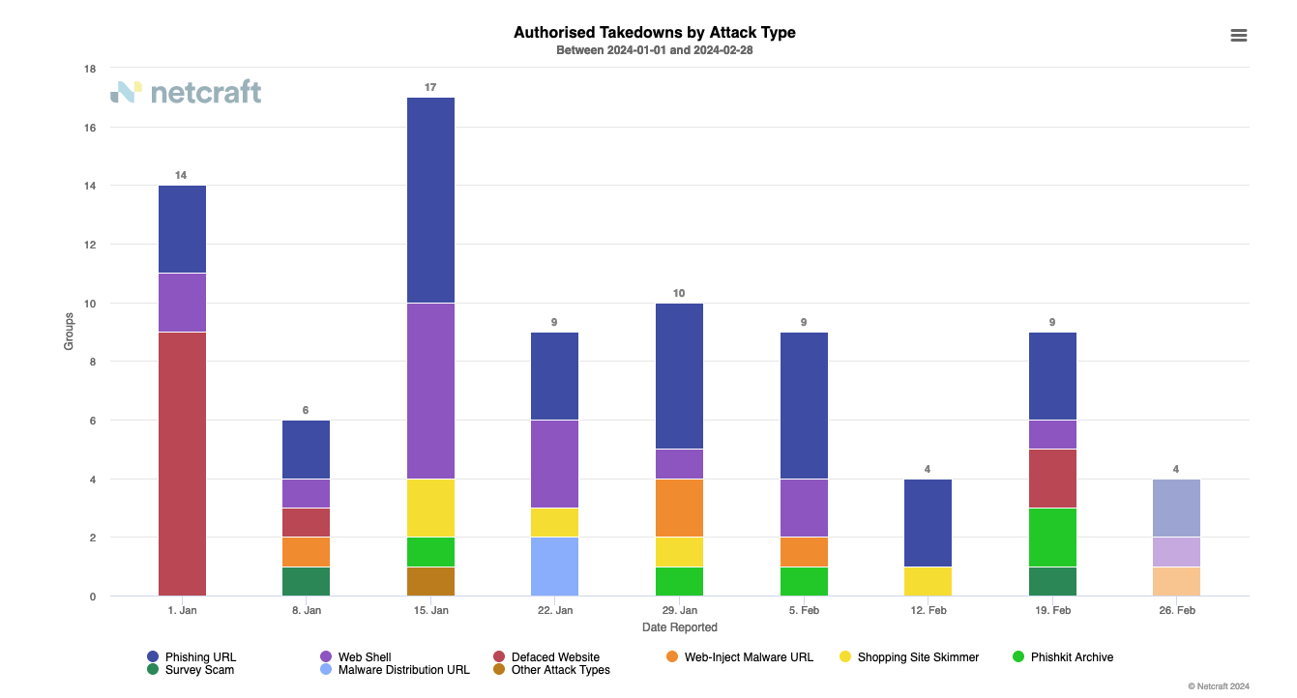
4.2 Handling of technical abuse

Slide 12
5. NIS 2 – Directive on security of network & info systems
Task Complexity
High:
Med:
Low:
5.1 Updated Roadmap
 | Q2 2023 | Q3 2023 | Q4 2023 | Q1 2024 | Q2 2024 | Q3 2024 | Q4 2024
Stage | Preliminary Analysis |  | Advocate & Monitor |  |  |  | Implement
Legislative Milestones |  | Awaiting Heads of Bill | Awaiting Heads of Bill | Awaiting Heads of Bill | Pre Legislative Scrutiny | Legislative Process | Transposed by Oct 17th
Alignment
Advocacy
Awareness
Audit Policy Impacts
Policy Impact Report
What We Heard Report
Adjust policy options as legislation evolves to ensure alignment
Fast Track Changes
Registrar Capacity Survey
Monitor legislative changes at each stage
PAC / Working Group Engagement (On-Going)
White Papers for public consultations
Advocate to relevant policymakers
RAR webinars for awareness
Registrar webinar trainings on final policy requirements
Open Letters and Blog Posts on NIS 2 Implications
ICANN & CENTR calls, conferences and workshops as needed

Slide 13
5. NIS 2 – Directive on security of network & info systems
RECAP OF NIS2 PLAN
Concentrate effort into 3 Focus Areas:
Alignment – Ensure that .IE policies and procedures comply with legislation.
Advocacy – Frequently collaborate with policymakers and present the concerns of stakeholders.
Awareness – Inform stakeholders of upcoming changes and preparing them for policy changes.
Key Deliverables Include:
Impact Report – Report on potential impacts of NIS2 on the .ie namespace.
What-We-Heard Report – Report summarizing stakeholder input, and partners’ input.
Policy Options – An evergreen document of proposed policy changes. Updated as legislation progresses.
White Papers/Open Letters/Blogs, etc… – Products used for consultations, advocacy, and awareness building.
Key trade-offs that must be balanced:
Effectiveness – Does the policy address the issue (is it compliant with NIS2?)
Efficiency – Is the policy scalable and not unduly burdensome?
Equitability – Does the policy unduly disadvantage, or advantage, any particular group?
Enforceability – Is the policy reasonable to expect, and impose, compliance upon?
Economy – Is the policy cost-effective?

Slide 14
5. NIS 2 – Directive on security of network & info systems
5.1 Tracker Update
Actions taken since last PAC Meeting (7th Dec 2024)
Alignment Ensure that .IE Policies and Processes are aligned with NIS2 requirements | Advocacy Frequently present the concerns and views of stakeholders to policymakers | Awareness Actively inform Registrars of impending changes from NIS2
NIS2 WG Meeting held (15 Feb 2024) Participation in CENTR & ICANN events regarding NIS2 (ongoing) | Engagement with Minister of State for DETE Publication in Eolas Magazine on NIS2 implications Open Letter for Minister Ryan (deferred) | Publication in Eolas Magazine on NIS2 Irish Tech News Podcast with CENTR Webinar on NIST Cyber Security Framework for Registrars planned (post-ICANN)
2
Actions taken
2
Actions taken
3
Action taken

Slide 15
5. NIS 2 – Directive on security of network & info systems
5.2 Key Updates and Emerging Issues
Release of Heads of Bill delayed to Q1 – 2024.
Guidelines for TLD Registries and Entities Providing Registration Services (EPRS) expected from NIS Cooperation Group end of March/early April.
Commission for Communications Regulation (ComReg) selected as Competent Authority.
New commissioner: Helen Dixon.
CENTR Legal & Regulatory Workshop (Feb 2024)
Registries beginning to investigate establishing compliance programs for their Registrars.

Slide 16
5. NIS 2 – Directive on security of network & info systems
5.3 Updates from the NIS2 working group
Met on 15th February 2024
Topics covered included:
Updates from the CENTR L&R ;
Discussion on Registrar Compliance; and,
Drafting a Potential Open Letter to Minister Ryan on NIS2

Slide 17
5. NIS 2 – Directive on security of network & info systems
5.4 Tour de Table
Tour de Table – NIS2 Updates from Participants’ Mother Ships

Slide 18
5. NIS 2 – Directive on security of network & info systems
5.5 Upcoming NIST Webinar
Session 1 – Managing Cyber Risks from a Regulatory Standpoint
Potentially March 12th
Objective: To understand basics of the NIST cybersecurity framework
Proposed Topics:
Fundamentals of NIST CSF
Lessons learned from NIS1 Compliance
Glimpse of NIS2 & CER Directives
Session 2 – Managing Cyber Risks from a Regulatory Standpoint
Potentially March 25th
Objective: To understand potential regulatory impacts of NIS2/CER on
Possible topics:
Key changes in NIS2/CER Directives affecting the sector
Regulatory compliance & enforcement measures for NIS2

Slide 19
6. Discussion – 2024 Priorities for the PAC
Potential Ideas:
Further changes to the .ie Policy Suite
Updating Privacy-Related Policies (Privacy Policy, Data & Document Retention, etc…)
Potential for a GDPR Code-of-Conduct under Article 40
Discussion: What policy or emerging should the PAC prepare for? Any policy initiatives it should undertake in 2024?

Slide 20
7. AOB
World Summit on the Information Society (WSIS)
United Nations General Assembly to review the overall implementation of WSIS Outcomes in 2025 (WSIS+20).
Potential impacts on internet governance and multi-stakeholderism.
Potential Extensions to Eligible Organisations
ComReg, CCPC, DPC, CnaM

Slide 21
8. Next Meeting Proposed date: 25th April 2024

